Slide 1









Theory of Complex Networks
Financial Networks
Guido Caldarelli
http://imt.lu/gc
CoeGSS
imt.lu/gc
@GuidoCaldarelli
Guido.Caldarelli@imtlucca.it

Slide 2



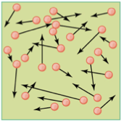
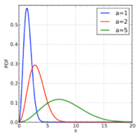
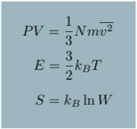
Why Statistical Physics and Networks ?
We take inspiration from standard approach
To describe our society
imt.lu/gc
@GuidoCaldarelli
￼
Guido.Caldarelli@imtlucca.it

Slide 3

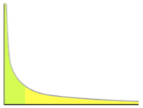

The new problems
Unfortunately
The situation is rather different in the case of society
We do not have any instrument to average individual behaviour
????
???
??
imt.lu/gc
@GuidoCaldarelli
Guido.Caldarelli@imtlucca.it

Slide 4
Definitions
Networks are real-world realizations of graphs
A graph is an ordered pair G=(V,E) comprising
    a set V of vertices (nodes, points)
    a set E of edges (arcs, lines)
degree is the number of edges per vertex
distance is the minimum number of edges between two vertices
diameter is the maximum of distances

Slide 5
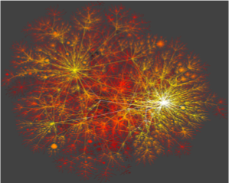
Universality

Slide 6

  Scientific Activity
Theory of Complex Networks
Financial Networks Stability
Economic Networks
Brain Networks
News & Misinformation
Smart Grids
Biological Networks

Slide 7


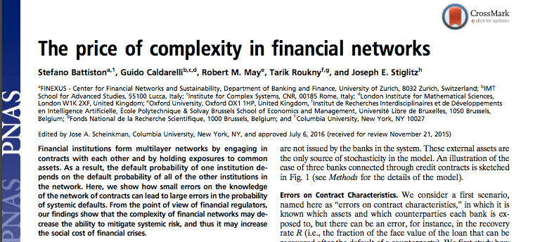


FINANCIAL NETWORKS
Robert May
House of Lords
Joe Stiglitz
Columbia NY
Stefano Battiston
Un. of Zurich

Slide 8
FINANCIAL NETWORKS
The DEBTRANK
i lent money to j in the interbank
j has a shock on the external assets (First Round)
what happens? (Network effects: Second Round)
j
i
Shares
Interbank
(deposit)
Interbank
loans
Shares
Interbank
(deposit)
Bonds
Interbank loans
Bonds
Households
(deposit)
Household
(deposit)
Other
Other
Mortgages
EQUITY
Mortgages
EQUITY
`
external shocks imply devaluation of counterparties assets

Slide 9
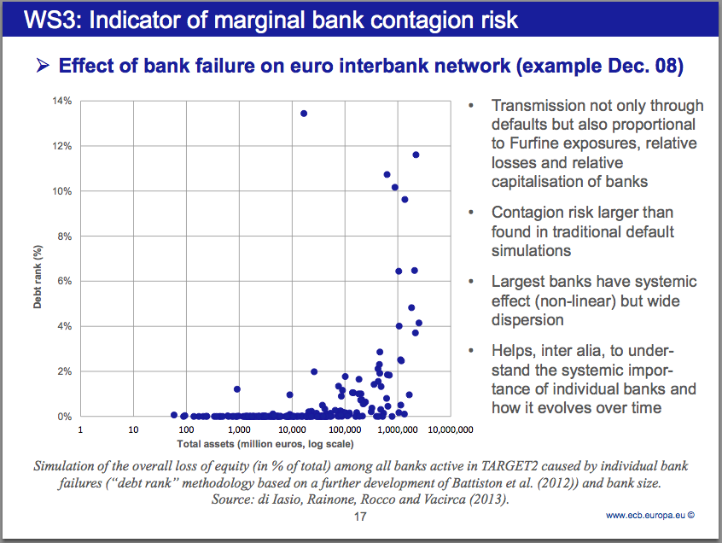

FINANCIAL NETWORKS
DebtRank allows to distinguish the different impact of institutions with similar size
Marco Bardoscia
London Institute for Mathematical Sciences
DebtRank shows that size is not enough to assess the impact
Collaborating with BoE, BuBa, Bank of Italy, Bank of Mexico

Slide 10
ECONOMIC NETWORKS
We analyse and reconstruct
bipartite networks
as those of countries & products

Slide 11
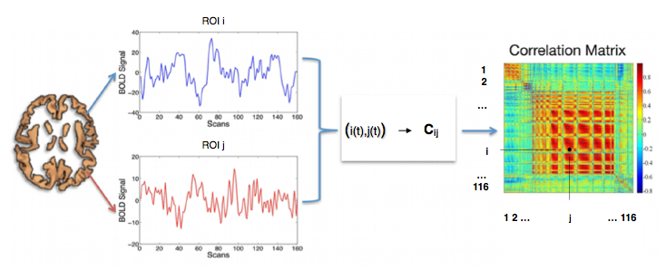
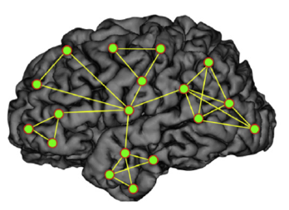
BRAIN NETWORKS
Link weight = Cij
fully connected
i
j
filtering

Slide 12
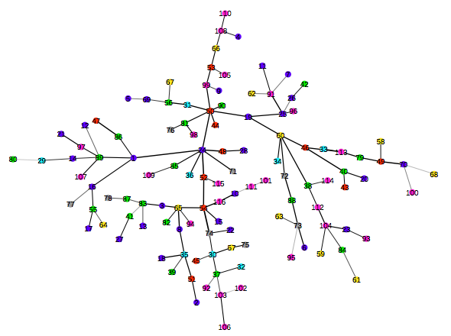
BRAIN NETWORKS
<- MST from data
Frontal Lobe
Insula & Cingulate Gyri
Random graph ->
Temporal Lobe
Occipital Lobe
Parietal Lobe
Central Structures
Posterior Fossa

Slide 13
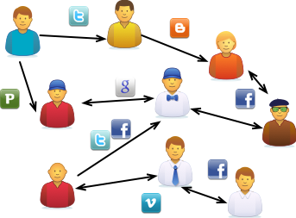
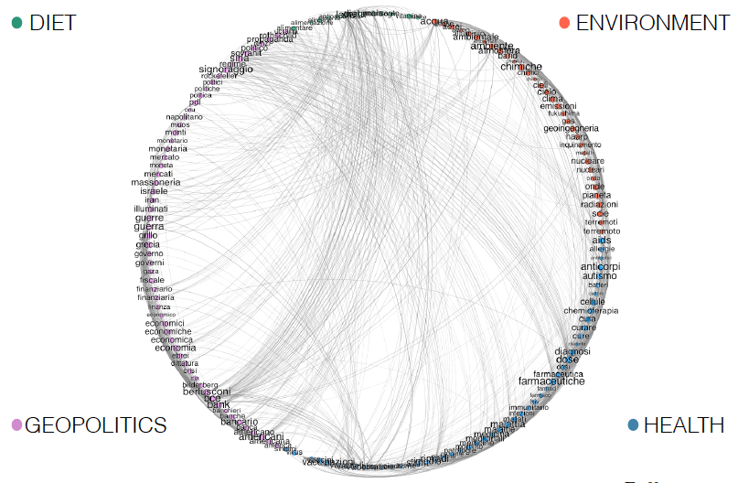
NEWS & MISINFORMATION
Technological Systems on which people
interact form a multilayer social network.
Not only the dynamics of interaction, but even the topology is unknown
On misinformation the
most discussed topics are
environment
health
geopolitcs
food/diet

Slide 14

NEWS AND MISINFORMATION

Slide 15


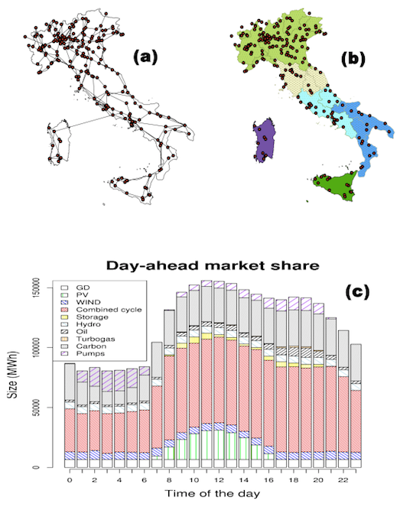
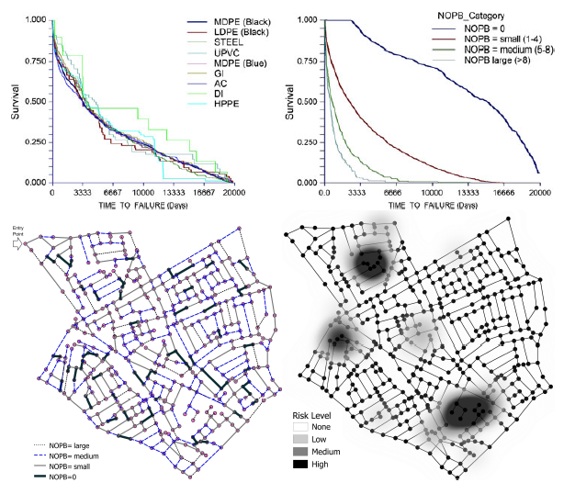
INFRASTRUCTURAL NETWORKS

Slide 16
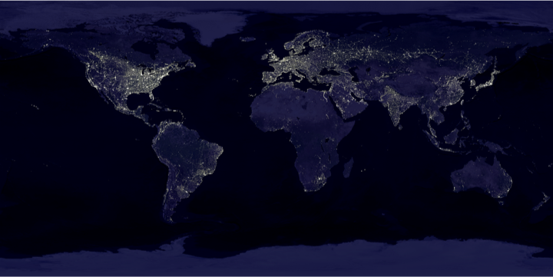




INFRASTRUCTURAL NETWORKS
The global urban system lives and develops by means of flows: Energy, material, water, information
Energy is the main driver for urban development
Cities consume about 70% of the global primary energy and emits more than 70% of the global GHG
Understanding the global network of cities and its dynamics is crucial

Slide 17
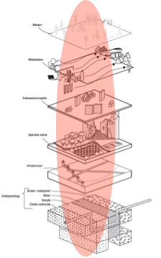
INFRASTRUCTURAL NETWORKS
Urban infrastructures: Hard, soft, intangible.
Multilevel network
Integration of the layers of the city connecting physical and social layers.
Understand this ML network means:
Accurate measures and monitoring for risks management
Improved resilience measures and adaptation to climate change
Social connection and inclusion of the citizens
Improving efficiency by means of awareness: new services and new business models for citizens
Enabling social innovation
Reduce GHG impact of the global urban system

Slide 18


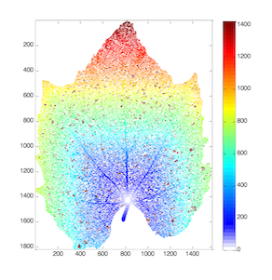

BIOLOGICAL NETWORKS
Networks arise in nature as a result of optimisation
Nature (as always) is a great source of inspiration
Stefano
Mancuso
Bela Bollobas

Slide 19
BIOLOGICAL NETWORKS

Slide 20
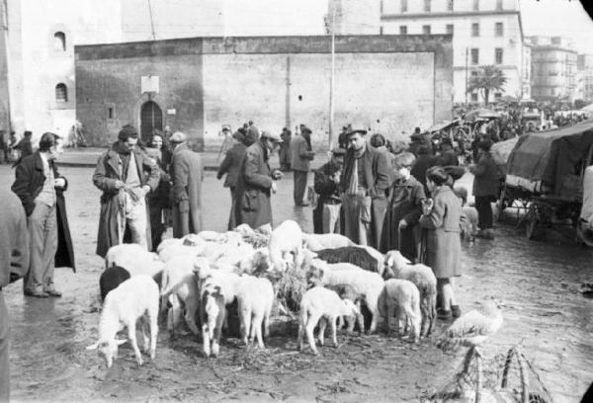


Why Financial Networks ?
Trade is a paramount example of Complex System
Many people create an unexpected behaviour
imt.lu/gc
@GuidoCaldarelli
Guido.Caldarelli@imtlucca.it

Slide 21

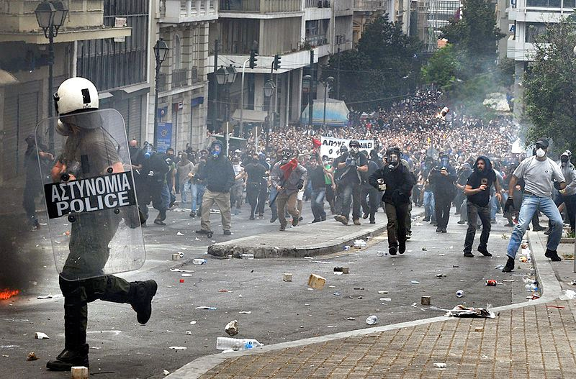

Financial Markets
why Financial Markets are important ?
Data available
Social Effects
imt.lu/gc
@GuidoCaldarelli
Guido.Caldarelli@imtlucca.it

Slide 22
Why networks are important ?
Network effects
  visualise and quantify effects of any interaction
  illustrate the mechanics of distress transmission
They matter because they
  describe distress amplification
  spot the information asymmetry bringing to too-big-to-fail situations
imt.lu/gc
@GuidoCaldarelli
Guido.Caldarelli@imtlucca.it

Slide 23
What are networks ?
Networks are mathematical objects composed by
vertices connected by edges
Number of connections per site NOT uniform
small distance between vertices
clusterised
imt.lu/gc
@GuidoCaldarelli
Guido.Caldarelli@imtlucca.it

Slide 24
Finance is useful to drive Real Economy
BUT Financial instruments can produce
social costs
unequality
slowing-down of the economy (i.e. delaying the passage to a green renewable-based economy)
Networks allow to distinguish between useful and less
useful effects
imt.lu/gc
@GuidoCaldarelli
Guido.Caldarelli@imtlucca.it

Slide 25
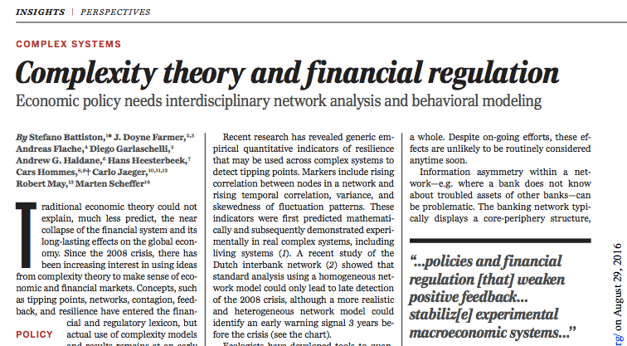

Impact
Why financial regulators ?
Financial Regulators, solve (or try to) problems on daily basis
For this reasons they are more open to people with different expertise (effective multidisciplinarity)
imt.lu/gc
@GuidoCaldarelli
Guido.Caldarelli@imtlucca.it

Slide 26
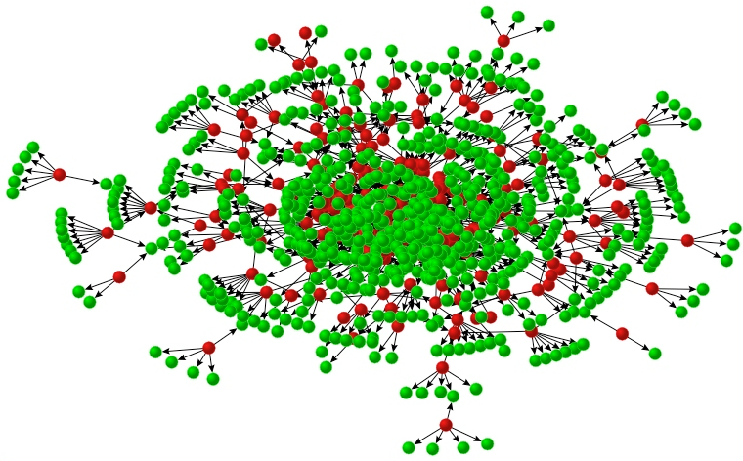


Our view on Financial Networks
Typically, we focus on network structure
but seldom we pay attention to vertex structure
Checking one vertex a complex behaviour emerges
imt.lu/gc
@GuidoCaldarelli
Guido.Caldarelli@imtlucca.it

Slide 27
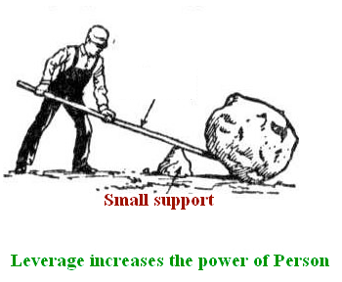

Aij is the Asset of type j owned by i i “owns” j
Lij is the Liability of i against j i “has a debt” with j
Ei is the equity (must be > 0 @maturity) owned by i E=A-L
Leverage
BASIC ACCOUNTING
(Accounting) Leverage in j is defined as
the investment of i divided by its equity
= Aij/Ei
S. Battiston, R. Kaushik, M. Puliga, P. Tasca, G. Caldarelli,
DebtRank: Too central to fail? FED and the Systemic Risk
Nature Scientific Reports 2 541 (2012).
M. Bardoscia, F. Caccioli, S. Battiston, G. Caldarelli,
DebtRank: A microscopic foundation for shock propagation
Plos One, 10, e0130406 (2015)
imt.lu/gc
@GuidoCaldarelli
Guido.Caldarelli@imtlucca.it

Slide 28

Propagation of distress
THE INNER DYNAMICS OF SINGLE FINANCIAL INSTITUTION
Shares
Interbank
deposits
Medium Shock on Households
Interbank loans
Bonds
LIABILITIES
ASSETS
Households
(deposits)
Shares
Interbank
deposits
Other
Households (mortgages)
Interbank loans
Bonds
LIABILITIES
EQUITY
Households
(deposits)
ASSETS
Other
Mortgages
EQUITY
Big Shock on Households
DISTRESS
Shares
Interbank
deposits
ASSETS
Interbank loans
Bonds
LIABILITIES
Households
(deposits)
Other
Households (mortgages)
EQUITY
BANKRUPT
imt.lu/gc
@GuidoCaldarelli
Guido.Caldarelli@imtlucca.it

Slide 29



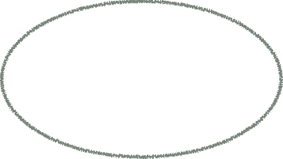
NEVA Network Valuation In Financial Systems
RISK
EVALUATION
RISK
DIVERSIFICATION
IMPACT
NEVA
Debtrank
INFORMATION
RECONSTRUCTION
of Networks
By P. Barucca et al. http://ssrn.com/abstract=2795583
imt.lu/gc
@GuidoCaldarelli
Guido.Caldarelli@imtlucca.it

Slide 30
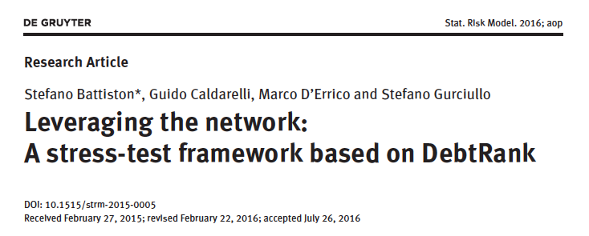
We can investigate along different directions
Shock type
Network estimation (when data are not available)
Contagion Dynamics (distress/default)
Systemic Risk Indicators
imt.lu/gc
@GuidoCaldarelli
Guido.Caldarelli@imtlucca.it

Slide 31
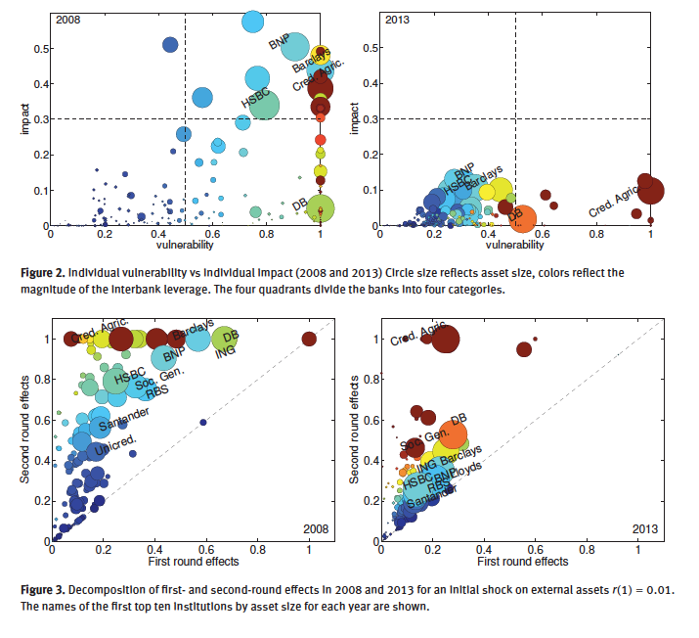

Slide 32
1 Debtrank
i lent money to j in the interbank network
j has a shock on the external assets (First Round)
what happens? (Network effects: Second Round)
j
i
Shares
Interbank
(deposit)
Interbank
loans
Shares
Interbank
(deposit)
Bonds
Interbank loans
Bonds
Households
(deposit)
Household
(deposit)
Other
Other
Mortgages
EQUITY
Mortgages
EQUITY
`
external shocks imply devaluation of counterparties assets
imt.lu/gc
@GuidoCaldarelli
Guido.Caldarelli@imtlucca.it

Slide 33
IMPACT MEASURE
DebtRank is the total loss of equity after distress of one/more institutions
DebtRank overcomes the limitations of the existing approaches (default-only, eigenvector centrality)
DebtRank allows to disentangle
1-round effects (i.e. shock on external assets)
2-round effects (i.e. distress induced in the interbank network)
3-round effects (i.e. induced by possible fire sales)
imt.lu/gc
@GuidoCaldarelli
Guido.Caldarelli@imtlucca.it

Slide 34


Consider the leverage = Aij/Ei as a measure of exposure of i to j
The key quantity is the relative loss of equity hi(t) = [Ei(0) -Ei(t)]/Ei(0)
To measure the impact on the other nodes we use the following process
ANOTHER DEFINITION OF DEBTRANK
Balance sheet is consistent at every timestep
E(t)=A(t)-L
Interbank loans
A relative loss of equity hi(t) of the borrower implies an equal relative devaluation of interbank asset of the lender
EQUITY
i
j
Aij(t+1)/Aij(t)=Ej(t)/Ej(t-1)
S. Battiston, R. Kaushik, M. Puliga, P. Tasca, G. Caldarelli,
DebtRank: Too central to fail? FED and the Systemic Risk
Nature Scientific Reports 2 541 (2012).
M. Bardoscia, F. Caccioli, S. Battiston, G. Caldarelli,
DebtRank: A microscopic foundation for shock propagation
Plos One, 10, e0130406 (2015)
imt.lu/gc
@GuidoCaldarelli
Guido.Caldarelli@imtlucca.it

Slide 35
HYPOTHESIS
Everything is based on the relation
Aij(t+1)/Aij(t)=Ej(t)/Ej(t-1)
The relation can be more complicated than simple linearity
One could ignore (or have an error on) the structure
RESULTS
Shocks are amplified by the leverage factor Lij= Aij/Ei
Can quantify effects of second round
imt.lu/gc
@GuidoCaldarelli
Guido.Caldarelli@imtlucca.it

Slide 36
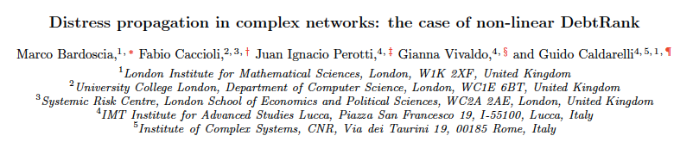
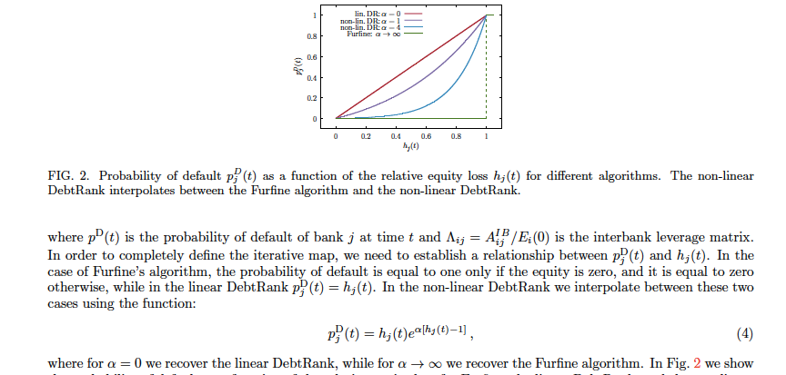
imt.lu/gc
@GuidoCaldarelli
Guido.Caldarelli@imtlucca.it

Slide 37
WORKING HYPOTHESIS
The equity reduction of i is equal to to the shock suffered by j
j
i
Interbank
(deposit)
Interbank
loans
Shares
Interbank
(deposit)
Bonds
Interbank loans
Bonds
Households
(deposit)
Household
(deposit)
Other
Other
Mortgages
EQUITY
Mortgages
EQUITY
Strong hypothesis, we are working to check what happens in general case

Slide 38
DEBTRANK IS AMONGST ECB TOOLS TO MONITOR TARGET2
DebtRank allows to distinguish the different impact of institutions with similar size
DebtRank shows that size is not enough to assess the impact
imt.lu/gc
@GuidoCaldarelli
Guido.Caldarelli@imtlucca.it

Slide 39
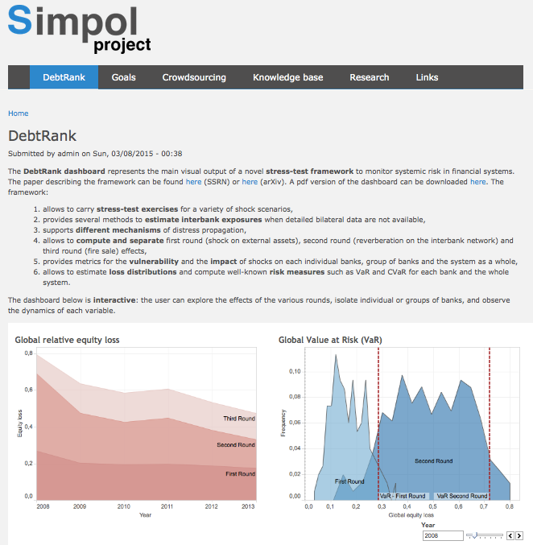
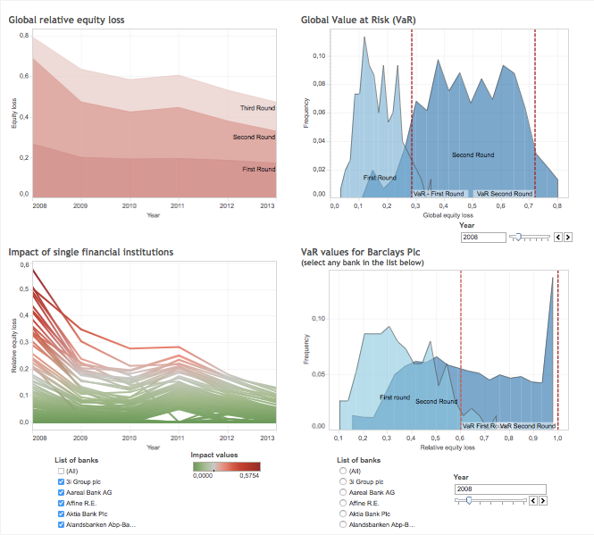
http://www.simpolproject.eu
We are realizing
Dashboards on
SIMPOL webpage
monitor (real-time) systemic impact of shock scenarios
individual banks / asset classes
Backward vs forward looking
We can enrich current stress-tests by combining network effects with familiar risk measures such value at risk (VaR)

Slide 40
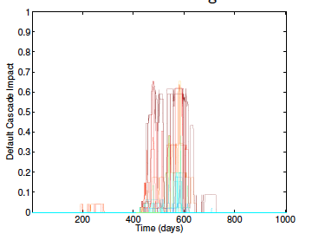
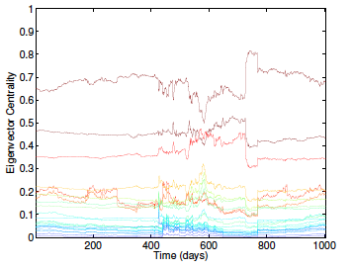
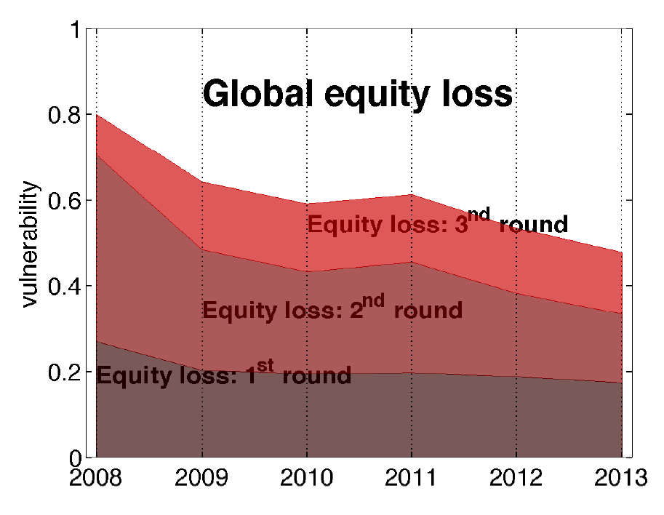
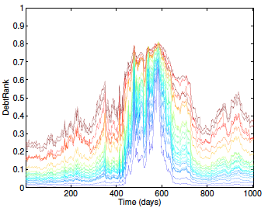
What do we learn ?
Second (network-based) round effects are typically AS LARGE AS first-round
effects: neglecting network effects implies to miss 100 % or more of the equity losses…..
DebtRank overcomes the limitations of the existing approaches (default-only, eigenvec. centrality)
imt.lu/gc
@GuidoCaldarelli
Guido.Caldarelli@imtlucca.it

Slide 41
Take home message
Networks take into account devaluation of assets
Leverage amplifies distress
Leverage network is crucial
M. Bardoscia, F. Caccioli, J.I. Perotti, G. Vivaldo, G. Caldarelli Distress propagation in complex networks: the case of non-linear DebtRank PLoS ONE 11(10): e0163825 (2016).
S. Battiston, M. D’Errico, G. Visentin, Rethinking Financial Contagion http://ssrn.com/abstract=2831143 (2016).
S. Battiston, M. D’Errico, S. Gurciullo, DebtRank and the network of leverage Journal of Alternative Investments, 18, 68–81 (2016).
M. Bardoscia, F. Caccioli, S. Battiston, G. Caldarelli, DebtRank: A microscopic foundation for shock propagation Plos One, 10 e0130406 (2015).
S. Battiston, M. D’ Errico, S. Gurciullo, G. Caldarelli, Leveraging the network: a stress-test framework based on DebtRank arXiv:1503.00621, Statitistics and Risk Modeling X, xxx (2016)
S. Battiston, R. Kaushik, M. Puliga, P. Tasca, G. Caldarelli, DebtRank: Too central to fail? FED and the Systemic Risk Nature Scientific Reports 2 541 (2012).
imt.lu/gc
@GuidoCaldarelli
Guido.Caldarelli@imtlucca.it

Slide 42
NEVA Network Valuation In Financial Systems
RISK
EVALUATION
NEVA
RISK
DIVERSIFICATION
IMPACT
Debtrank
INFORMATION
RECONSTRUCTION
of Networks
By P. Barucca et al. http://ssrn.com/abstract=2795583
imt.lu/gc
@GuidoCaldarelli
Guido.Caldarelli@imtlucca.it

Slide 43
2 Structural Instability
Different (intertwingled) Research lines
Price of Complexity
How the leverage amplifies the uncertainties on exposures
Pathways to instability
The role of topology in the stability of interbank system
Multiplex Structure of exposures
How other products (i.e. CDS) enter in the game
imt.lu/gc
@GuidoCaldarelli
Guido.Caldarelli@imtlucca.it

Slide 44
The price of complexity
S. Battiston, et al, PNAS early edition August 23 2016
imt.lu/gc
@GuidoCaldarelli
Guido.Caldarelli@imtlucca.it

Slide 45
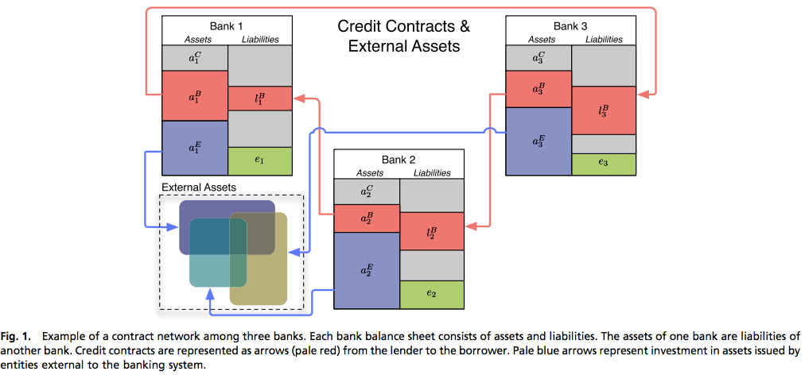
Analytic Derivation of the linked probability of defaults
imt.lu/gc
@GuidoCaldarelli
Guido.Caldarelli@imtlucca.it

Slide 46
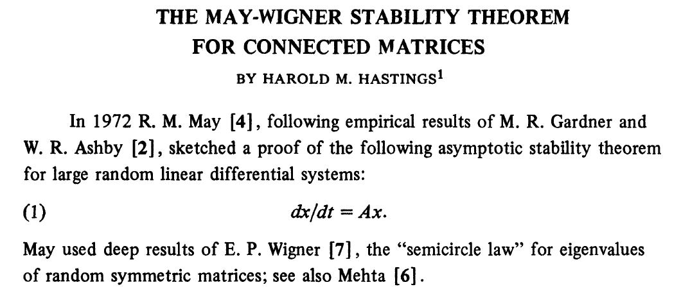
Pathways to instability
M. Bardoscia, S. Battiston, F. Caccioli, G. Caldarelli,
Pathways towards instability in Financial Networks arXiv:1602.05883, submitted to Nature Communication
imt.lu/gc
@GuidoCaldarelli
Guido.Caldarelli@imtlucca.it

Slide 47



In matricial form this reads
which is a linear map with fixed point
The fixed point is stable if the largest eigenvalue
Otherwise, shocks will be amplified and at least one bank will default.
Now we consider the matrix of leverages, that gives the network of leverages
imt.lu/gc
@GuidoCaldarelli
Guido.Caldarelli@imtlucca.it

Slide 48


Despite the considerable body of work on financial contagion,
there is no simple relationship between the topology of a network and
BUT
The system can become instable if
The leverage increases (obvious)
The number of banks increases (bad)
The links between banks increase (worse)
For graphs without cycles
presence of cycles is a necessary condition for instability
(although not sufficient).
imt.lu/gc
@GuidoCaldarelli
Guido.Caldarelli@imtlucca.it

Slide 49
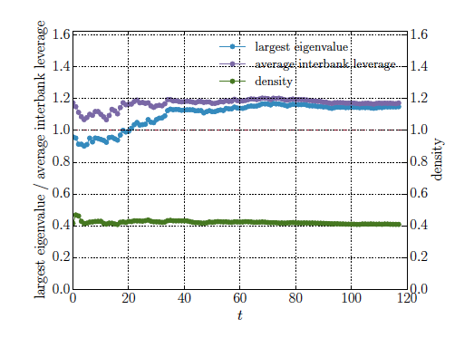
ADD BANKS
a stable network with average interbank leverage larger than one becomes
unstable as new banks are added to the system.
Instability is genuinely driven by the fact that fluctuations in the asymptotic distribution of max shrink as n becomes larger:
imt.lu/gc
@GuidoCaldarelli
Guido.Caldarelli@imtlucca.it

Slide 50
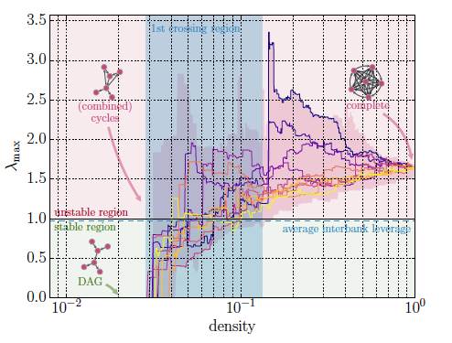
ADD EDGES
As an example we used top 50 European banks and used their balance sheets.
Every time a new edge is added, we re-balance the interbank exposures so that the interbank leverages are always
consistent with the real balance sheets.
We can see that densities as low as 3% are sufficient to reach instability.
imt.lu/gc
@GuidoCaldarelli
Guido.Caldarelli@imtlucca.it

Slide 51
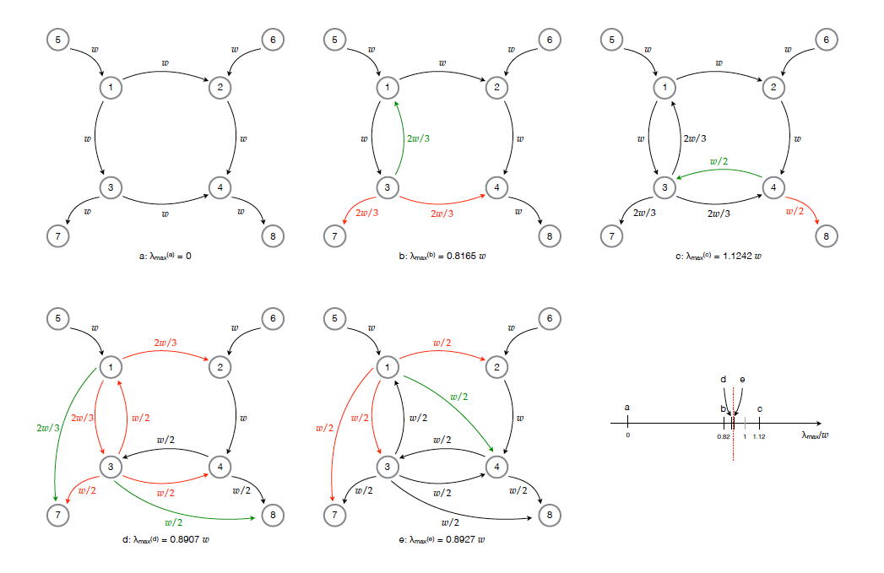
PLAY WITH TOPOLOGY
Toy model of Interbank network oscillating between stability and instability
imt.lu/gc
@GuidoCaldarelli
Guido.Caldarelli@imtlucca.it

Slide 52
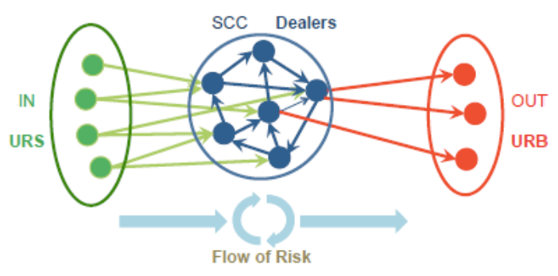
Novel visualization of the CDS derivatives network:
Finds a Bow-tie structure
identifies location of risk, how risk flows between entities
• propagation of risk downstream to all dealers and all ultimate risk seller
imt.lu/gc
@GuidoCaldarelli
Guido.Caldarelli@imtlucca.it

Slide 53
Take home message
Networks topology affects stability
Spectral properties of Leverage matrix matter
P. Barucca, M. Bardoscia, F. Caccioli, M. D’Errico, G. Visentin, S. Battiston, G. Caldarelli Network Valuation in Financial Systems SSRN http://ssrn.com/abstract=2795583 (2016)
S. Battiston, G. Caldarelli, R. May, T. Roukny, J.E. Stieglitz, The Price of Complexity in Financial Networks PNAS X, xxx (2016).
M. Bardoscia, S. Battiston, F. Caccioli, G. Caldarelli Pathways towards instability in Financial Networks, arXiv:1602.05883
T. Roukny,. H. Bersini, H. Pirotte, G. Caldarelli, S. Battiston, Default Cascades in Complex Networks: Topology and Systemic Risk Scientific Reports, 3, 2759 (2016).
S. Battiston, M. D'Errico, T. Peltonen, M. Scheicher Passing the hot potato: how does credit risk flow in the CDS market? Workpaper ECB
imt.lu/gc
@GuidoCaldarelli
Guido.Caldarelli@imtlucca.it

Slide 54
What do we learn ?
Diversification could make the financial system more efficient and more liquid
but
Diversification make the system unstable

Slide 55
NEVA Network Valuation In Financial Systems
RISK
EVALUATION
NEVA
RISK
DIVERSIFICATION
IMPACT
Debtrank
INFORMATION
RECONSTRUCTION
of Networks
By P. Barucca et al. http://ssrn.com/abstract=2795583
imt.lu/gc
@GuidoCaldarelli
Guido.Caldarelli@imtlucca.it

Slide 56
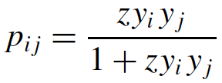
3 Reconstruction (Self-correlation)
By knowing only a subgraph we have a clue of the whole
Based on Fitness model and entropy consideration
Institutions have an intrinsic fitness
i,j —-> xi, xj
Linking function
Bianconi, G., Barabási, A-L Europhysics Letters 54: 436–442 (2001)
K.-I. Goh, B. Kahng, and D. Kim, Phys. Rev. Lett. 87, 278701 (2001);
Caldarelli, G., Capocci, A., De Los Rios, P. Munoz, M-A Phys. Rev. Lett. 89, 258702 (2002).
imt.lu/gc
@GuidoCaldarelli
Guido.Caldarelli@imtlucca.it

Slide 57
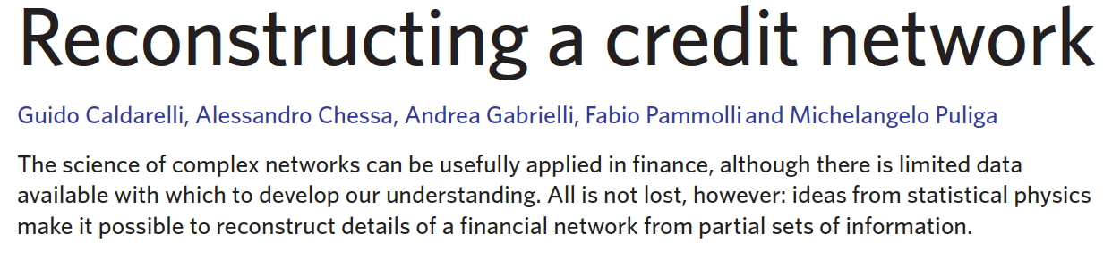

Reconstructing Networks is necessary because
Sensitive data issues
Genuine lack of information
PHYSICS REPORTS
N. Phys
9,125 (2013)
G. Cimini, T. Squartini, D. Garlaschelli, A. Gabrielli,
Systemic risk analysis in reconstructed economic and financial networks",
Nature Scientific Reports 5 15758 (2015),
G. Cimini, T. Squartini, A. Gabrielli, D. Garlaschelli,
Estimating topological properties of weighted networks from limited information",
Phys. Rev. E 92, 040802(R) (2015)
Garlaschelli, D., Loffredo, M.I.
Generalized Bose-Fermi Statistics and Structural Correlations in Weighted Networks.
Phys. Rev. Lett. 102, 038701 (2009)
Squartini, T., Garlaschelli, D.:
Analytical maximum-likelihood method to detect patterns in real networks.
New Journ. Phys. 13, 083001 (2011)
Saracco F, Di Clemente R., Gabrielli A, Squartini F.
Randomizing bipartite networks: the case of the World Trade Web
Nature Scientific Reports 5, 10595 (2015)
imt.lu/gc
@GuidoCaldarelli
Guido.Caldarelli@imtlucca.it

Slide 58

In which sense self-correlation ?
Standard model of Graph growth is the ER Random Graph
p
decide each edge with prob p
?
p
This model produces characteristic networks that have been
studied in detail since 50 years
P. Erdos, A. Rényi On random graphs. Publicationes Mathematicae Debrecen, 6, 290-297 (1959)
imt.lu/gc
@GuidoCaldarelli
Guido.Caldarelli@imtlucca.it

Slide 59
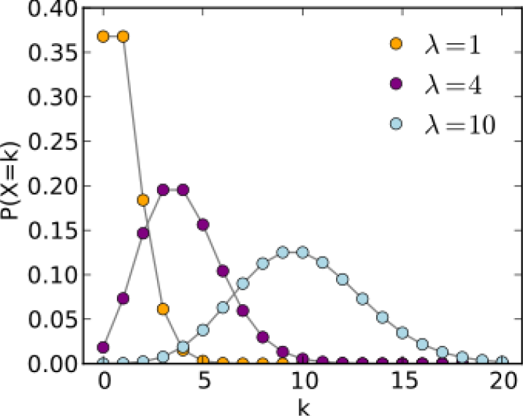


Binomial —> Poisson
in the limits
Random graph have characteristic size for the degree distribution, given by average degree <k>=pN
imt.lu/gc
@GuidoCaldarelli
Guido.Caldarelli@imtlucca.it

Slide 60
Can we attain fat tails in graph quantities distribution ?
Do not toss any coin
but assign a value (fitness) to each vertex
x’s drawn from r(x)
f(x1,x2)
x2
x1
?
f(x1,x3)
x4
x3
edges are drawn with a probability
depending upon fitness of vertices
Graphs are function of both r(x) and f(x1,x2)
imt.lu/gc
@GuidoCaldarelli
Guido.Caldarelli@imtlucca.it

Slide 61
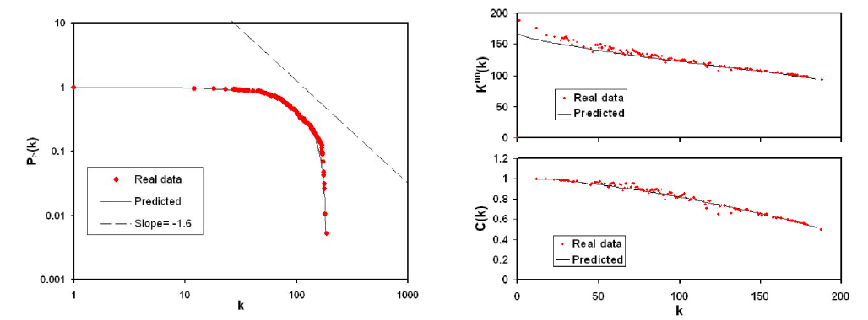
In financial networks typically r(x) is Pareto-like
f(x1,x2) can be determined with methods like max-likelihood
D. Garlaschelli, T. D. Matteo, T. Aste, G. Caldarelli, and M. I. Loffredo, EPJB 57, 159 (2007)
imt.lu/gc
@GuidoCaldarelli
Guido.Caldarelli@imtlucca.it

Slide 62
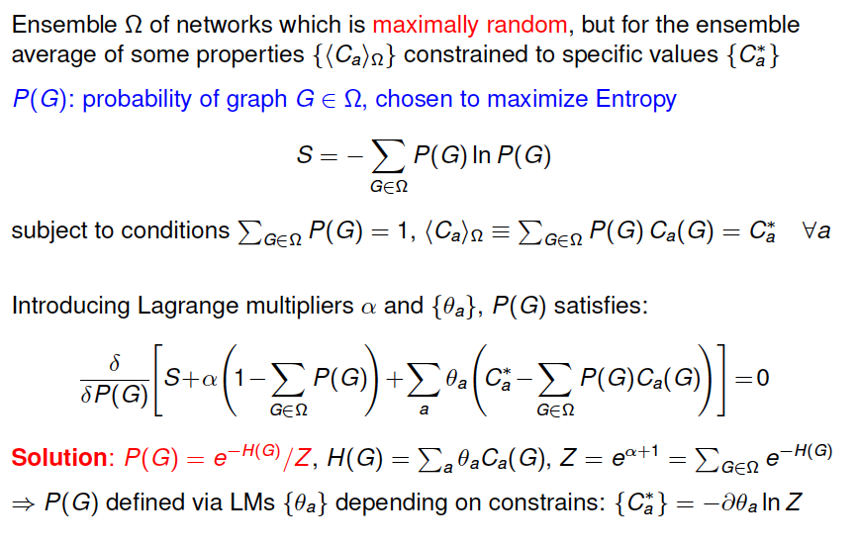
imt.lu/gc
@GuidoCaldarelli
Guido.Caldarelli@imtlucca.it

Slide 63
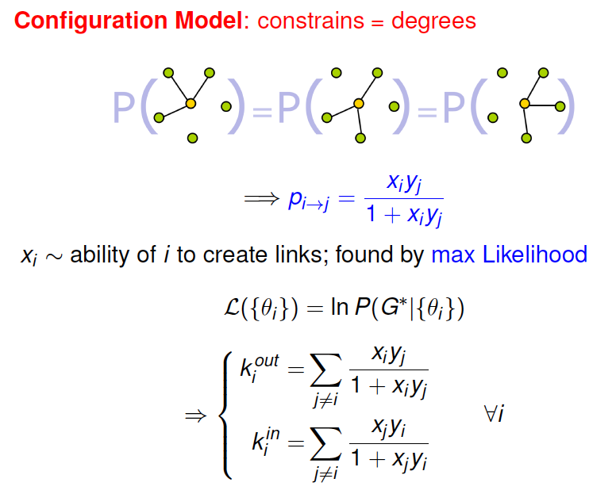
imt.lu/gc
@GuidoCaldarelli
Guido.Caldarelli@imtlucca.it

Slide 64
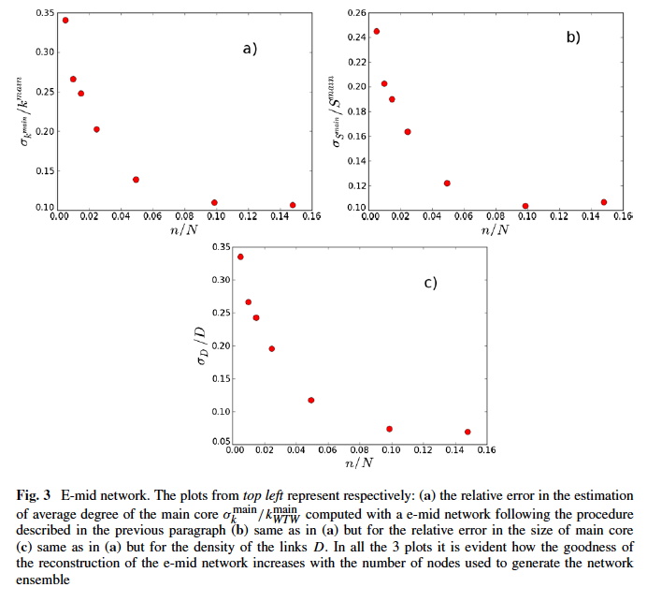
RESULTS
we test on complete datasets the feature of the method
binary
undirected
network of
banks
E-Mid
imt.lu/gc
@GuidoCaldarelli
Guido.Caldarelli@imtlucca.it

Slide 65
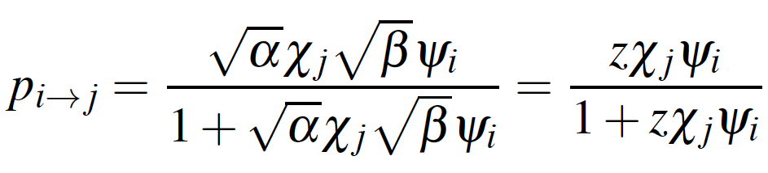
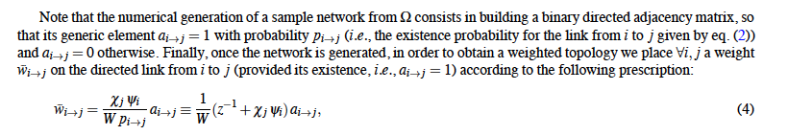
Reconstruction nr. 2
By knowing only part of the whole graph we have a clue of the rest
Actually you can reconstruct directed networks in/out degree
BUT ALSO WEIGHTED
G. Cimini, T. Squartini, D. Garlaschelli, A. Gabrielli, Systemic risk analysis in reconstructed economic and financial networks”, arXiv:1411.7613v2 (2014),
imt.lu/gc
@GuidoCaldarelli
Guido.Caldarelli@imtlucca.it

Slide 66
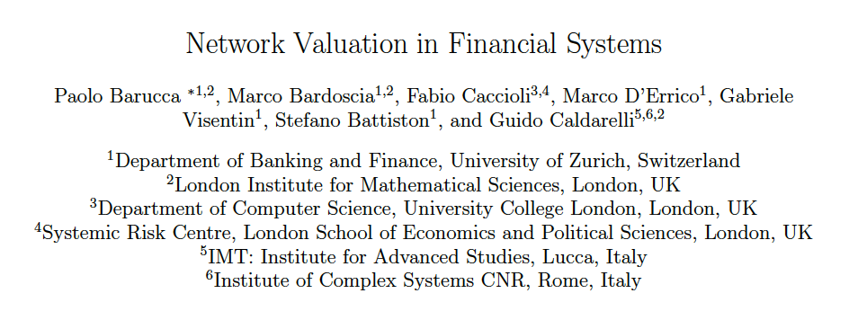
The NEVA Model
By P. Barucca et al. http://ssrn.com/abstract=2795583
imt.lu/gc
@GuidoCaldarelli
Guido.Caldarelli@imtlucca.it

Slide 67
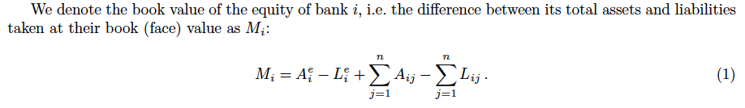
DEFINITION
We introduce a network valuation model (NEVA)
for the ex-ante valuation of claims among financial institutions connected in a network of liabilities.
Motivation
Joining two streams of work
    uncertainty on values of financial assets (Merton model)
    interconnectedness between institutions (the network !)
        default contagion (e.g. Eisenberg and Noe)
        propagation of distress (e.g. DebtRank)
Setup
imt.lu/gc
@GuidoCaldarelli
Guido.Caldarelli@imtlucca.it

Slide 68


Slide 69
Results
If each bank performs the valuation of its claims (e.g. expected value) on other banks's obligations at time t as a function of other banks' equity and its own external assets, based on local information
then market players agree on consistent values for equities that:
    minimise losses
    account for uncertainty on external shocks
    account for interdependence via the network.
(Various types of contracts are covered: loans, bonds, equity holdings. However, e.g. no naked-CDS.
All previous contagion models are a special case)
Older approaches
By assigning the valuation functions appropriately the map recovers the following models:
  Eisenberg-Noe 2001,
  Furfine 2003,
  Rogers-Veraart 2013,
  DebtRank 2012
DebtRank is the consistent network valuation of interbank securities in the case of ex-ante uncertainty with a given uniform distribution of shocks on external assets at time T and external assets recovery rate = 0.
imt.lu/gc
The analytical meaning of DebtRank
New: Endogenous DebtRank with generic shock distribution
DebtRank distress propagation can be combined with EN idea of
endogenous recovery. By assigning the valuation functions appropriately
the (E ) map is equivalent to a map of EN in the limit of t ! T and for
t < T provides consistent valuation with endogenous recovery
@GuidoCaldarelli
Guido.Caldarelli@imtlucca.it

Slide 70

imt.lu/gc
@GuidoCaldarelli
Guido.Caldarelli@imtlucca.it

Slide 71

imt.lu/gc
@GuidoCaldarelli
Guido.Caldarelli@imtlucca.it

Slide 72
Conclusions
Network based (Debtrank) measures of impact improve the estimate of sys. risk
Network modelling (FITNESS MODEL) allows to reconstruct missing information
Networks quantify effects of instability in financial markets
Networks are essential ingredient in the analytical evaluation of systemic risk
imt.lu/gc
@GuidoCaldarelli
Guido.Caldarelli@imtlucca.it

Slide 73





(Short) BIBLIOGRAPHY
P. Barucca, M. Bardoscia, M. D'Errico, G. Visentin, S. Battiston, G. Caldarelli
Network valuation in Financial Systems
SSRN:2795583
M. Bardoscia, S. Battiston, F. Caccioli, G. Caldarelli,
Pathways towards instability in Financial Networks
arXiv:1602.05883
M. Bardoscia, F. Caccioli, J.I. Perotti, G. Vivaldo, G. Caldarelli
Distress propagation in complex networks: the case of non-linear DebtRank
arXiv:1512.04460
S. Battiston, G. Caldarelli, R. May, T. Roukny, J. Stiglitz,
The Price of Complexity in Financial Networks
Submitted (2015) http://ssrn.com/abstract=2594028
M. Bardoscia, F. Caccioli, S. Battiston, G. Caldarelli,
DebtRank: A microscopic foundation for shock propagation
Plos One, 10 e0130406 (2015)
S. Battiston, M. D’ Errico, S. Gurciullo, G. Caldarelli,
Leveraging the network: a stress-test framework based on DebtRank,
arXiv:1503.00621 Submitted (2015)
G. Cimini, T. Squartini, N. Musmeci, M. Puliga, A. Gabrielli, D. Garlaschelli, S. Battiston, G. Caldarelli,
Reconstructing topological properties of complex networks using the fitness model
Lecture Notes in Computer Science (Socinfo 2014) 8852 323-333 (2015).
S. Battiston, G. Caldarelli,
Systemic Risk in Financial Networks,
Journal of Financial Managements Markets and Institutions 1, 129-154 (2014)
S. Battiston, R. Kaushik, M. Puliga, P. Tasca, G. Caldarelli,
DebtRank: Too central to fail? FED and the Systemic Risk
Nature Scientific Reports 2 541 (2012).
G. Caldarelli, A. Chessa, A. Gabrielli, F. Pammolli, M. Puliga,
Reconstructing a Credit Network
Nature Physics 9 125 (2013).
S. Battiston, G. Caldarelli, Co-Pierre Georg, R. May, J. Stiglitz,
Complex Derivatives,
Nature Physics 9 123 (2013).
imt.lu/gc
@GuidoCaldarelli
Guido.Caldarelli@imtlucca.it

Slide 74


Slide 76


