Slide 1


Novel machine learning models for text mining and human mobility analytics
Stan Matwin
Institute for Big Data Analytics
Dalhousie University
Halifax, NS, Canada
stan@cs.dal.ca

Slide 2
Roadmap
Deep Learning
... and text data - why embeddings
Brief review of embeddings for text
Algebra instead of networks: negative examples
Our idea: SVD-NS and results
Embeddings for trajectory data: How
Results for ocean vessels
GeoLife results
Work in progress
Some thoughts on Deep Learning
Behrouz H. Soleimani, Stan Matwin
Spectral Word Embedding with Negative Sampling, AAAI 2018, New Orleans Feb. 2018
X Jiang, E.. de Souza, A. Pesaranghader, B. Hu, D. L. Silver, S. Matwin:
TrajectoryNet: an embedded GPS trajectory representation for point-based classification using recurrent neural networks. CASCON 2017, Toronto, Nov. 2017.:
Best Paper Award

Slide 3


Deep learning – the promise
Machine Learning system
representation
knowledge
examples
Machine Learning system
architecture
knowledge
examples
from
to
representation
representation

Slide 4
Deep learning for text: word embeddings
Limitations of BOWs – no context!
Embeddings give the context as short, dense vectors
Embeddings are learned from data
embeddings improve the results of many [NLP] tasks by 5-10%

Slide 5
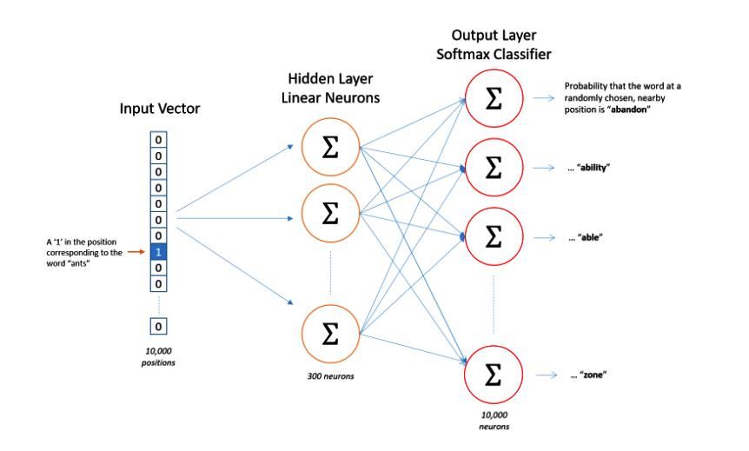
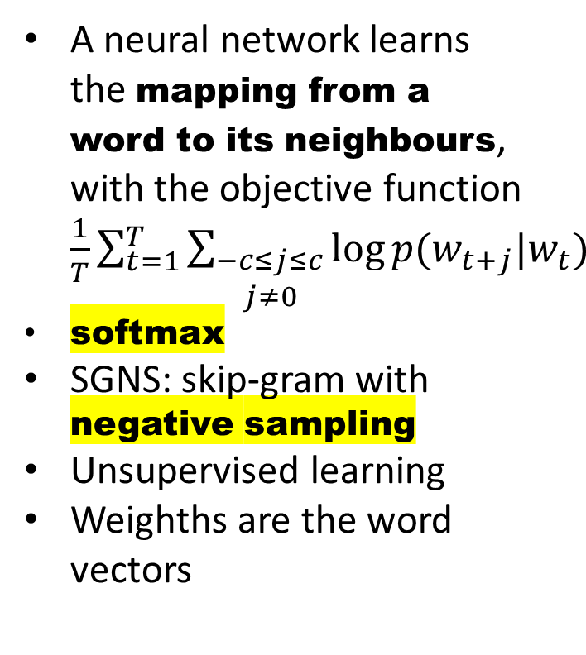
Word2Vec: learning word embeddings
(Mikolov et al. 2013)
From Ch. McCormick, 2016
A neural network learns the mapping from a word to its neighbours, with the objective function $\frac{1}{T}\sum_{t=1}^{T}{\sum_{\begin{aligned}−c≤j≤c \\ j≠0\end{aligned}}{\log{p(w_{t+j}|w_{t})}}}$
softmax
SGNS: skip-gram with negative sampling
Unsupervised learning
Weighths are the word vectors
max
skip-gram
Notes:
Shallow neural network (1 hidden layer)
Main idea for continuous bag of words (CBOW): Predict center word from sum of surrounding word vectors instead of predicting surrounding single words from center word as in skipgram model

Slide 6
Skipgram details
Hidden layer matrix
Multiplying the input layer vector by that matrix → selecting a row from the matrix
Rows of the hidden layer matrix = word vectors
Phrases + words (|V|!)
Words are sampled w/prob. inverse to their frequency
Negative sampling →

Slide 7
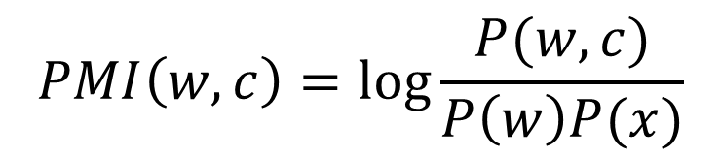
Algebra instead of neural networks
Pointwise Mutual Information: measure of strength of the relationship between words in a corpus
Completely unrelated words have a negative PMI
[Goldberg and Levy 2014] : SGNS ~ SVD decomposition of the Shifted Positive PMI (SPPMI) matrix
$$PMI\left(w,c\right)=\log{\frac{P(w,c)}{P\left(w\right)P(x)}}$$

Slide 8
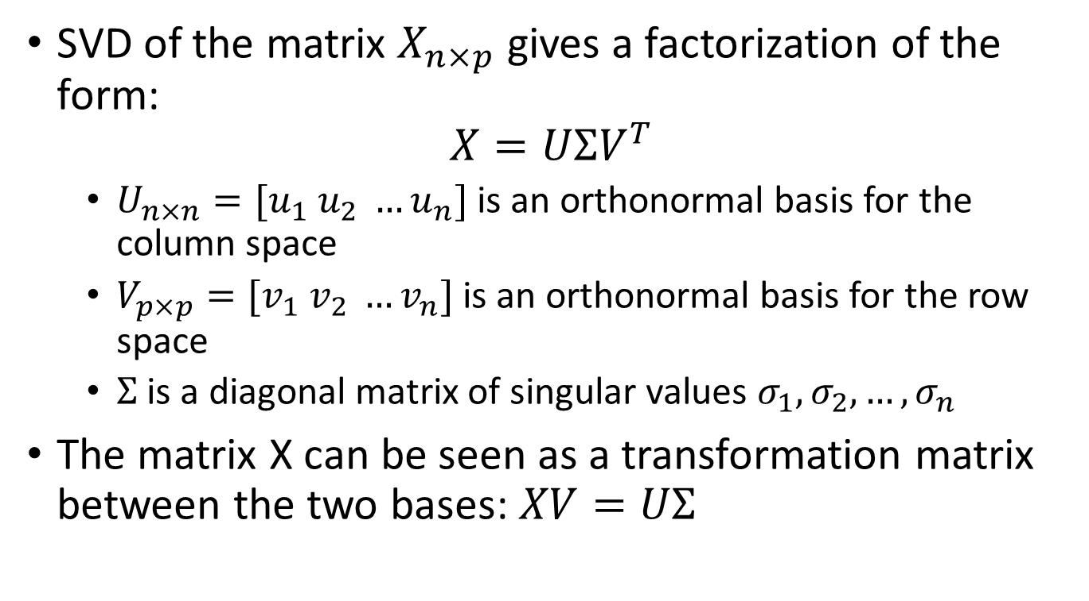
Some algebra
SVD of the matrix $X_{n×p}$ gives a factorization of the form:
$$X=UΣV^{T}$$
  $U_{n×n}=[u_{1} u_{2} …u_{n}]$ is an orthonormal basis for the column space
  $V_{p×p}=[v_{1} v_{2} …v_{n}]$ is an orthonormal basis for the row space
  $Σ$ is a diagonal matrix of singular values $σ_{1},σ_{2}, …,σ_{n}$
The matrix X can be seen as a transformation matrix between the two bases: $XV=UΣ$

Slide 9
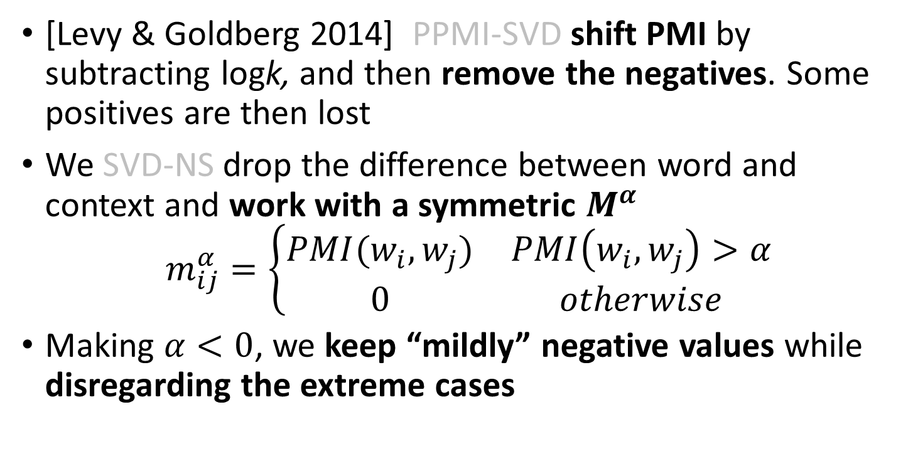
SVD-NS vs PPMI-SVD
[Levy & Goldberg 2014] PPMI-SVD shift PMI by subtracting logk, and then remove the negatives. Some positives are then lost
We SVD-NS drop the difference between word and context and work with a symmetric $M^{α}$
$$m_{ij}^{α}=\left\{\begin{matrix}PMI(w_{i},w_{j}) & PMI\left(w_{i},w_{j}\right)>α \\ 0 & otherwise\end{matrix}\right.$$
Making $α<0$, we keep “mildly” negative values while disregarding the extreme cases

Slide 10
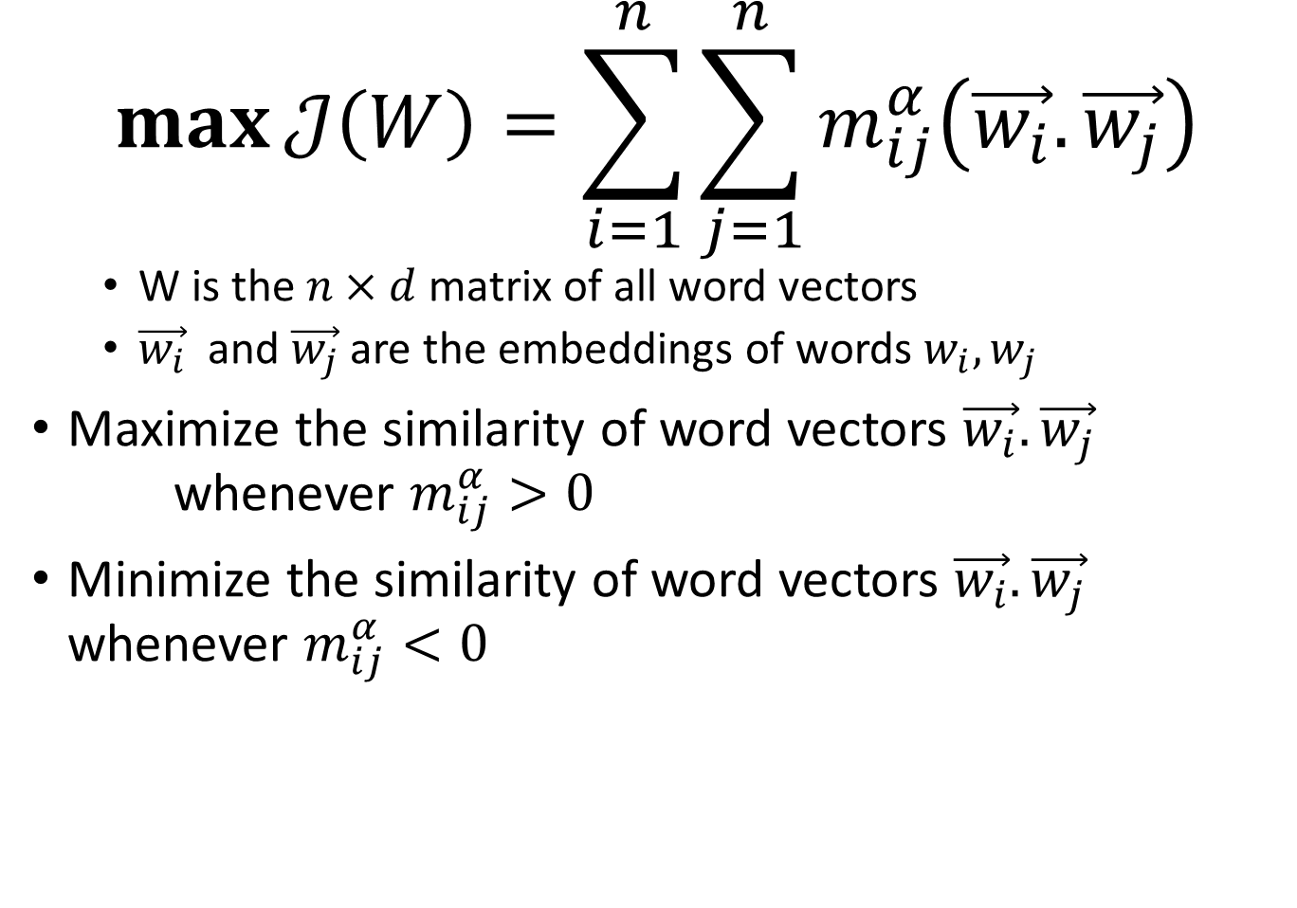
SVD-NS objective function
$$\max{𝒥\left(W\right)=\sum_{i=1}^{n}{\sum_{j=1}^{n}{m_{ij}^{α}\left(\vec{w_{i}}.\vec{w_{j}}\right)}}}$$
  W is the $n×d$ matrix of all word vectors
  $\vec{w_{i}}$ and $\vec{w_{j}}$ are the embeddings of words $w_{i}, w_{j}$
Maximize the similarity of word vectors $\vec{w_{i}}.\vec{w_{j}}$ whenever $m_{ij}^{α}>0$
Minimize the similarity of word vectors $\vec{w_{i}}.\vec{w_{j}}$ whenever $m_{ij}^{α}<0$
word similarity

Slide 11
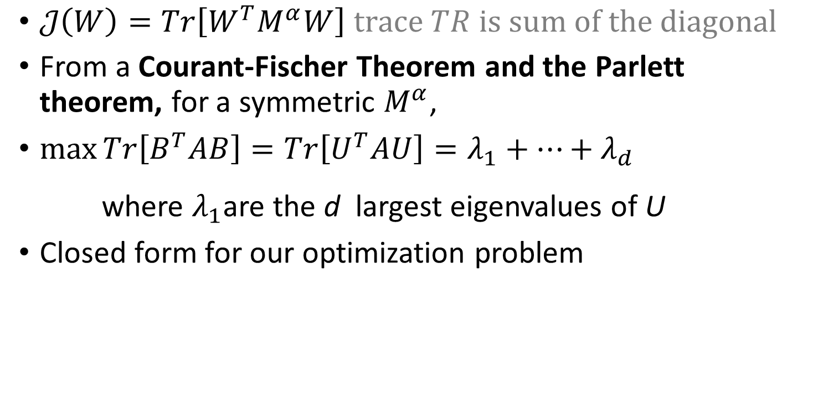
A bit more algebra
$𝒥\left(W\right)=Tr\left[W^{T}M^{α}W\right] trace TR is sum of the diagonal$
From a Courant-Fischer Theorem and the Parlett theorem, for a symmetric $M^{α}$,
$\max_{}{Tr\left[B^{T}AB\right]=Tr\left[U^{T}AU\right]=λ_{1}+…+λ_{d}}$
where $λ_{1}$are the d largest eigenvalues of U
Closed form for our optimization problem
eigenvalues = values of λ for which the determinant of the matrix (A − λI) = 0
If Av =λ v, then v is an eigenvector of the linear transformation A.

Slide 12
SVD-NS
Experiments – Training Dataset
Wikipedia dump
Preprocessing
  Extracting clean text of articles (using WikiExtractor)
  Removing special & non-English characters
Tokenization: 2.1B tokens
Vocabulary: ~9M unique words
  160K unique words: either English words or high frequency
embeddings of size d = 100

Slide 13
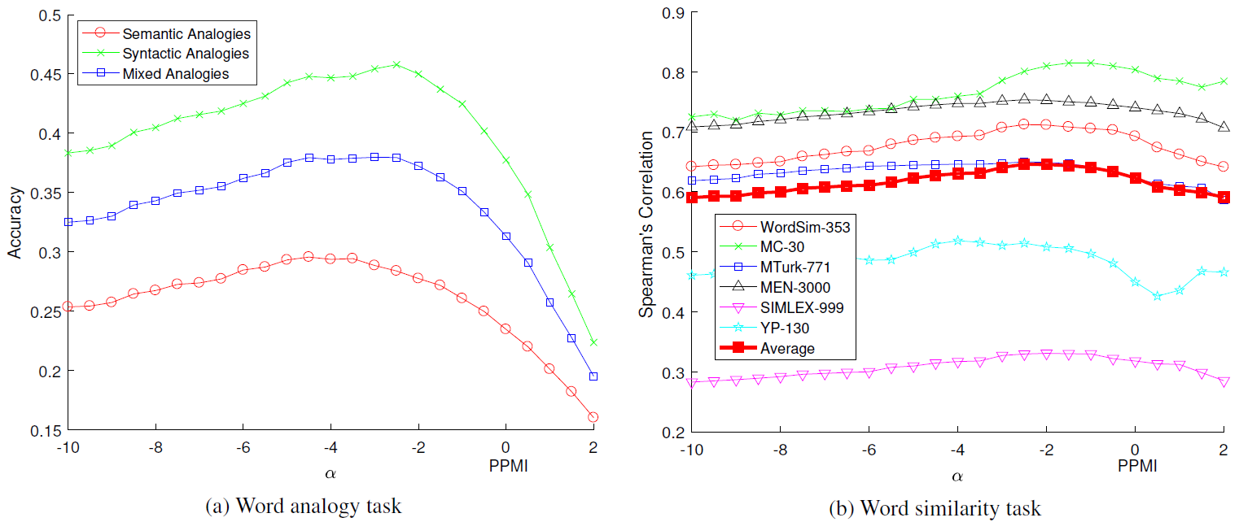
SVD-NS
The volume of negative examples
Notes:
It is also noteworthy to mention that positive examples are indeed more informative than negative examples. This means that excessive use of negative examples can have destructive effects on the quality of final embedding since the algorithm will mostly focus on making negative examples far apart rather than making word vectors with strong association closer to each other. However, we show that appropriate use of negative examples improves the distribution of words in the embedded space and prevents the concentration effect.

Slide 14
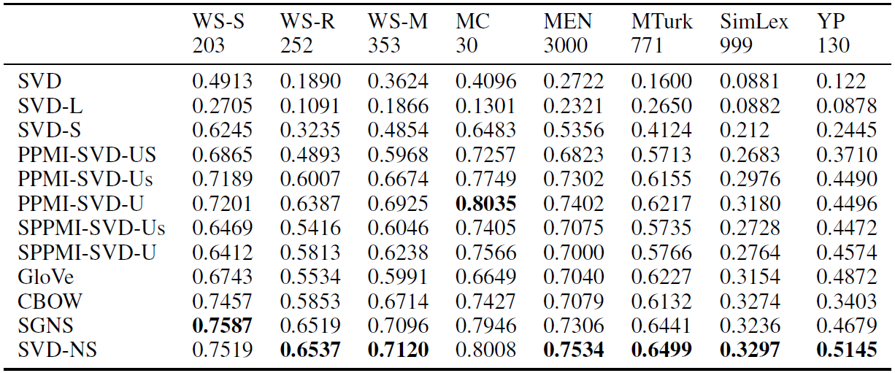



SVD-NS - Results
Comparison with other algorithms - similarity task
$$x_{max}=100$$
$$k=5$$
$$α=−2.5$$
Notes:
In analogy task, Word2Vec and GloVe are far better.

Slide 15
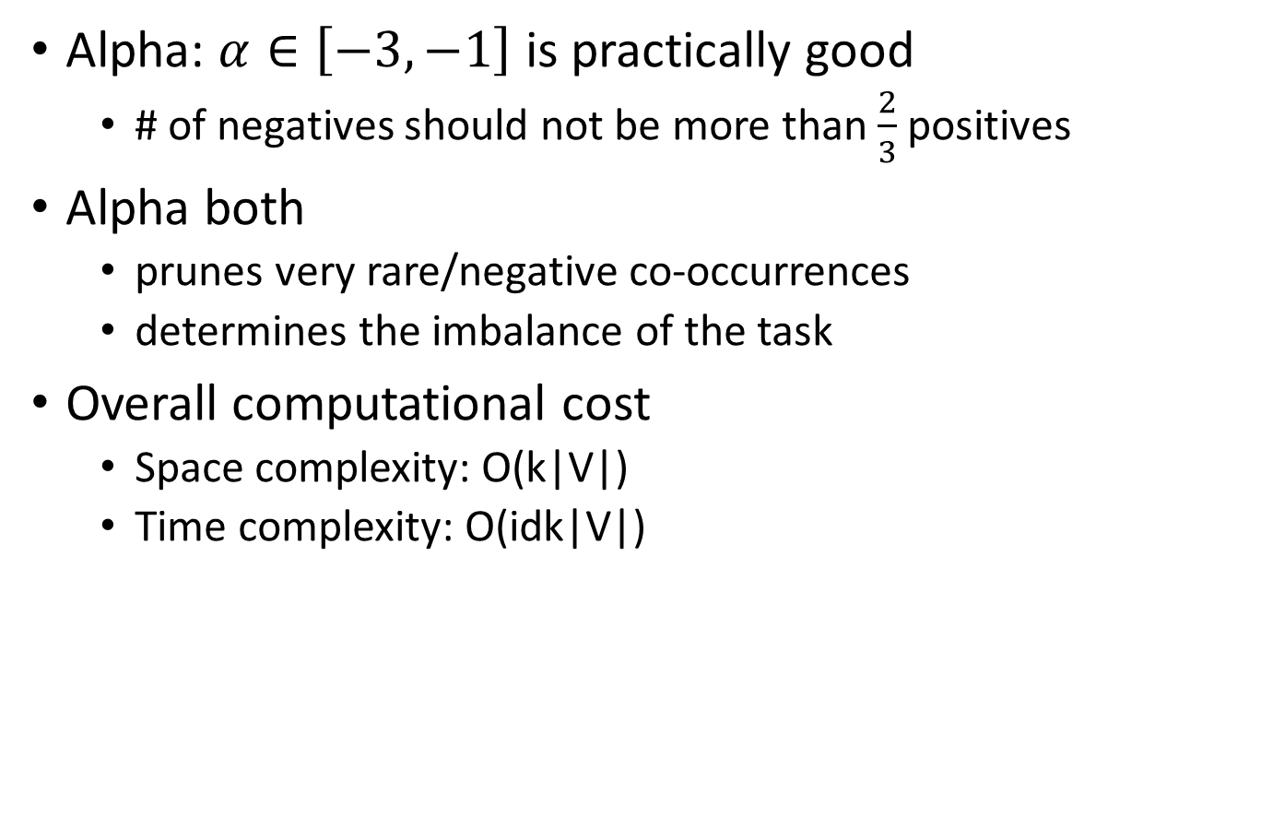
Discussion
Alpha: $α∈\left[−3, −1\right]$ is practically good
  # of negatives should not be more than $\frac{2}{3}$ positives
Alpha both
  prunes very rare/negative co-occurrences
  determines the imbalance of the task
Overall computational cost
  Space complexity: O(k|V|)
  Time complexity: O(idk|V|)
Notes:
|V| is the size of vocabulary
k is the average number of co-words for word
d is the dimensionality of embedding
i is the number of iterations needed to find an eigenvector (in the Lanczos sparse eigensolver we used)

Slide 16
Take home...
We exploited the use of negative examples by proposing a count-based spectral algorithm
Better approximation of the skip-gram objective function than SVD factorization or shifted PPMI
Achieved very good results on word similarity, but not yet on analogy
Future work
  Multi sense embedding
  Sentence and document embedding

Slide 17

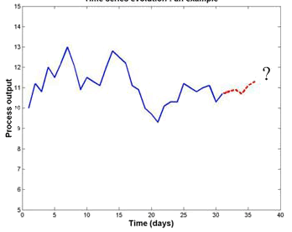
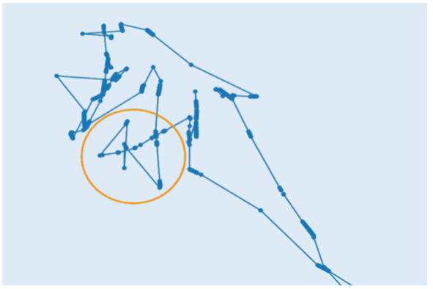
Trajectory Data Mining
digital crumbs…
Prediction
Classification

Slide 18
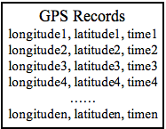
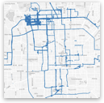
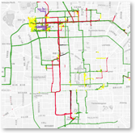
Point-based GPS Trajectory Classification
Structured prediction

Slide 19
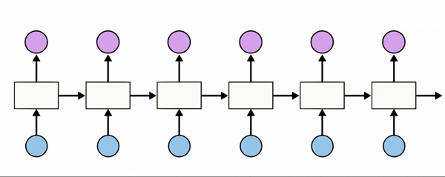
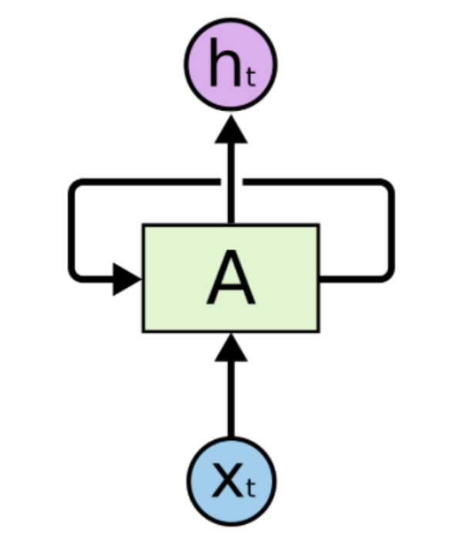
Background: Recurrent Neural Networks
unfold
For sequential data
Recurrent connections retain state info.
Vanishing/exploding gradient
Long short-term memory
Gated Recurrent Units (GRUs)
Picture credit: http://colah.github.io/posts/2015-08-Understanding-LSTMs/

Slide 20
Main Challenges
Trajectory representation
Model architecture
Effective optimization
a low-dimensional feature space (3 features)
features are heterogeneous
difficult to develop feature compositions

Slide 21
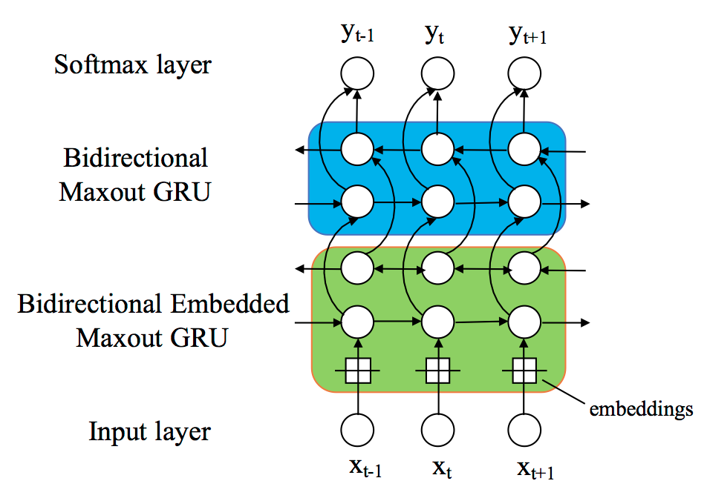
Proposed Framework
GPS Records
Longitude1,latitude1,time1
Longitude1,latitude1,time1
Longitude1,latitude1,time1
…...
Segment-based
Features
Discretization
Embedded
Maxout GRU
Point-based
Features

Slide 22
Embeddings for trajectories
map a low-dimensional, heterogeneous feature space
into a representation capturing higher level semantics
the speed example: 10 km/h
not the value, but its interpretation in a given context

Slide 23
Word embedding maps a word to a vector, to better represent the semantics of words.
word
w₂₁ | w₂₂ | w₂₃
can we build vector space representations for continuous features?
continuous features may supply rich semantics.
(different feature values could have very different meanings)
Learn embeddings for continuous features
map a feature value to a vector, to better represent the semantics of continuous feature.
Smoothness prior: similar values have similar meanings
- physical attributes (e.g. speed and acceleration) generally do not change abruptly in a space or time
- semantics of a particular continuous attribute are more or less coherent around a given value, e.g. speed
changes in transportation modes do not occur all of a sudden.

Slide 24
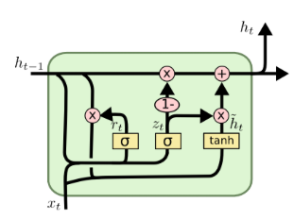
feature f1 in the range of [0, 3]
The discretization trick for embeddings
discretization algorithm
0
1
2
3
class label Y
each interval has its own embedding vector
when f1=1.5
0
1
2
3
f₁ = 1.5
one-hot encoding
[0,1,0]
w₁₁ | w₁₂ | w₁₃
w₂₁ | w₂₂ | w₂₃
w₃₁ | w₃₂ | w₃₃
w₂₁ | w₂₂ | w₂₃
one-hot encoding
Multiply by
The embedding matrix W
embedding vector when f1=1.5
W
backprop classification error to train embedding

Slide 25
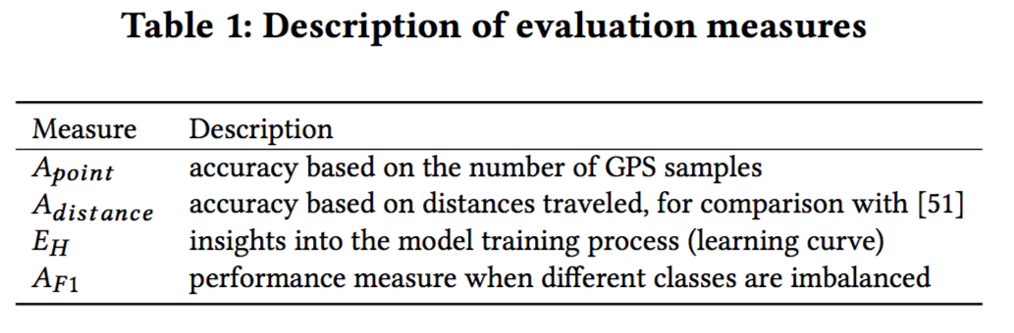
Experiment Setting
23 people in total
Over 2 million GPS records
Training, Validation, Testing: 16, 1 and 6 people

Slide 26
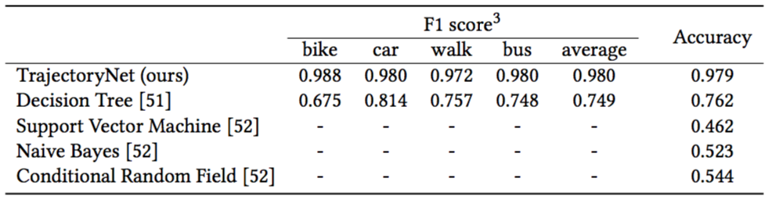
Results

Slide 27
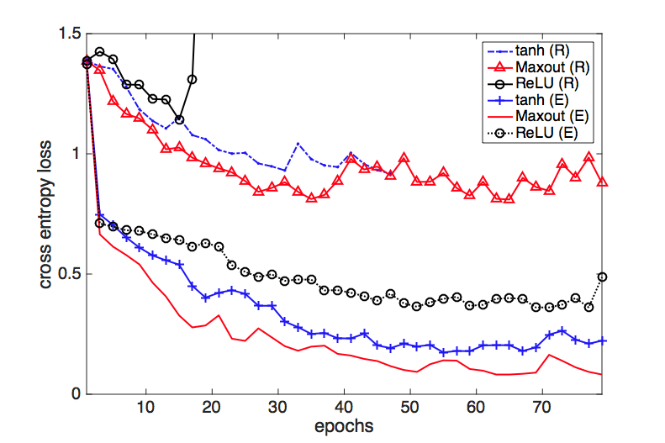
Results: the effects of embedding
no embedding
use embedding

Slide 28
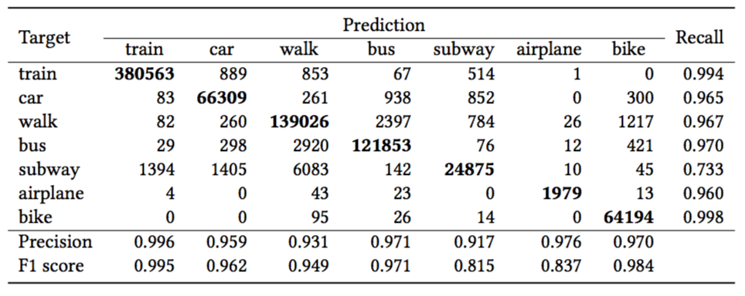
Results: seven-class classification

Slide 29
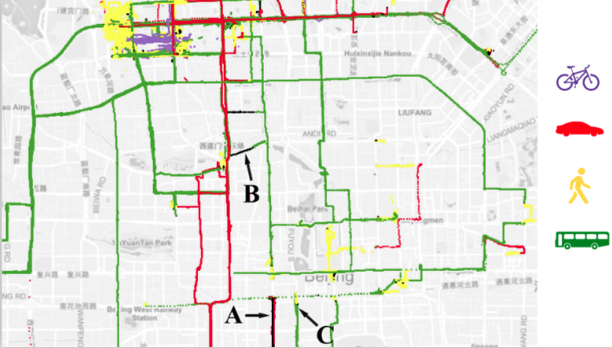
Visualization of classification results
misclassifications:
A: car → bus
B: bus → car
C: transition

Slide 30
“classical”: Machine Learning
Machine Learning system
representation
knowledge
examples

Slide 31
Deep learning
highly mathematical
Finding non-linear relationships between data, resulting in learning a representation
non-interpretable
Recurrent neural networks
  What is it:
Machine Learning system
architecture
Long Short-term memory
knowledge
examples
embeddings
Convolutional neural networks
Deep reinforcement learning
representation
representation

Slide 32
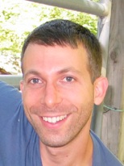
alphaZero [DeepMind, Silver et al, 2017]
Self-training chess/go playing program
after 9 hours of training, defeated Stockfish 8 in a time-controlled 100-game tournament (28, 0, 72)
Different even from “standard” Deep Learning:
Machine Learning system
knowledge
architecture
Generative
Adversarial
Networks
examples
representation
representation

Slide 33


Q&A?

Slide 34
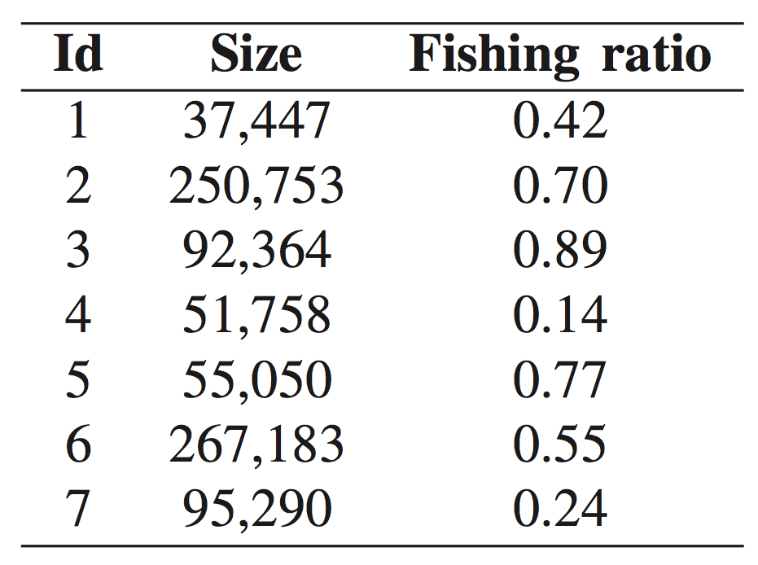
Trawlers Fishing Activity Classification
Features:
longitude
latitude
speed
Data:
irregular size
very long sequences
imbalanced

Slide 35
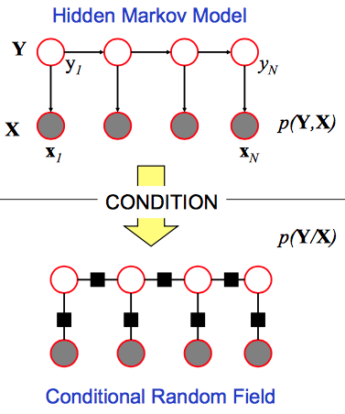
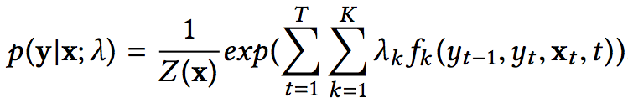
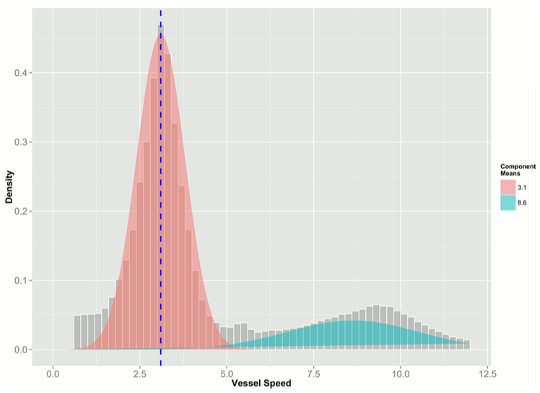
Existing Methods
generative-discriminative pair (Ng et al., 2002)
  Hidden Markov Model (Souza et al.)
Conditional Random Fields (Hu et al.)
decision boundary is log-linear
requires the design of features
Gaussian Mixture (Natale et al., 2015)
  only use speed information
  build one model for each vessel

Slide 36
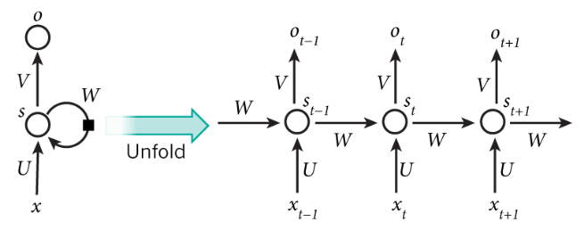
Recurrent Neural Networks (RNN)
model temporal dependencies of sequential data
suffers from vanishing and exploding gradients

Slide 37
Challenges in Applying RNNs
a low-dimensional feature space (3 features)
features are heterogeneous
difficult to develop feature compositions

Slide 38
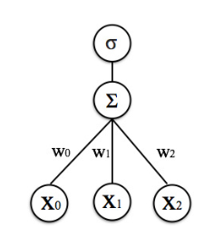
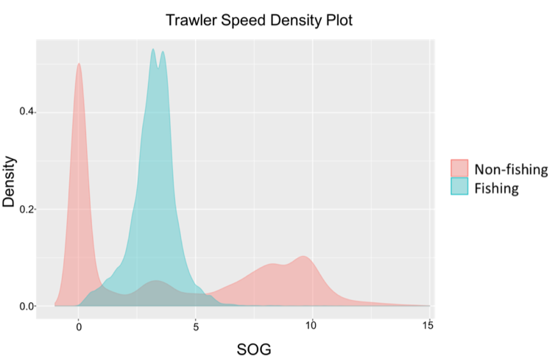
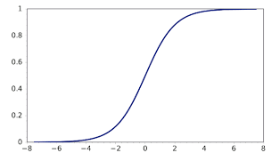
Challenges for Activation Functions
neural network: nonlinearly transformed linear model
learn non-monotonic relationship

Slide 39
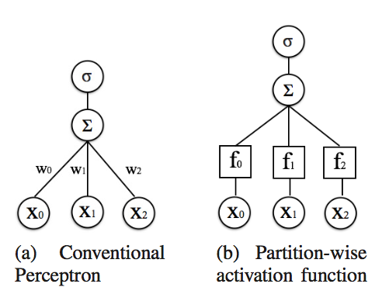
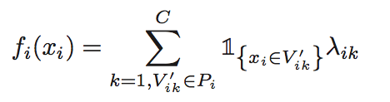

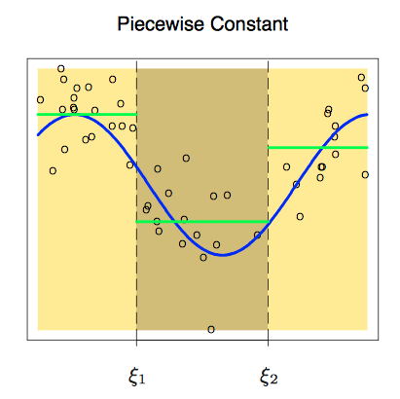
The Remedy: partition-wise activation function
different parameters for different intervals
learns basis expansion for each feature
learns embedding on the feature space
can approximate any nonlinear function
image from: The Element of Statistical Learning

Slide 40
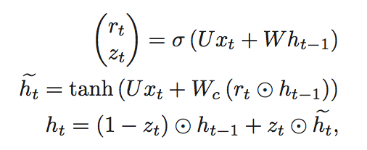
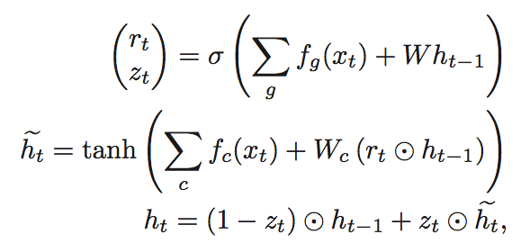
Partition-wise Gated Recurrent Units
Gated Recurrent Units
partition-wise Gated Recurrent Units

Slide 41
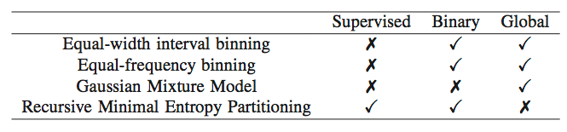
Different Partition Strategies

Slide 42
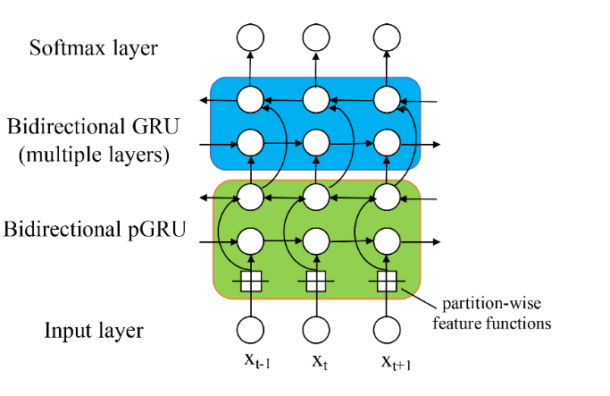
Network Architecture

Slide 43
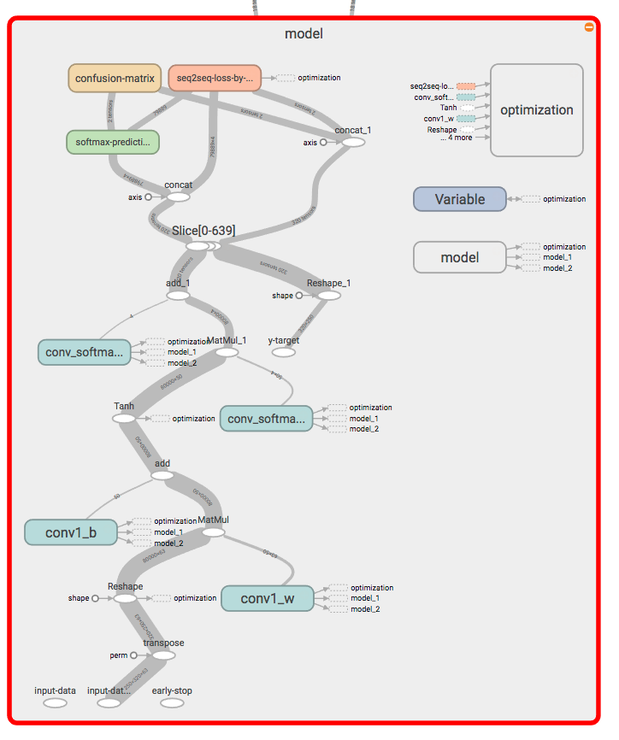
Tensorflow
RNNs are hard to parallelize
GPU can train up to 1 layer
  Memory limitation/overhead

Slide 44
Evaluation Method
leave one batch out
F1 score

Slide 45
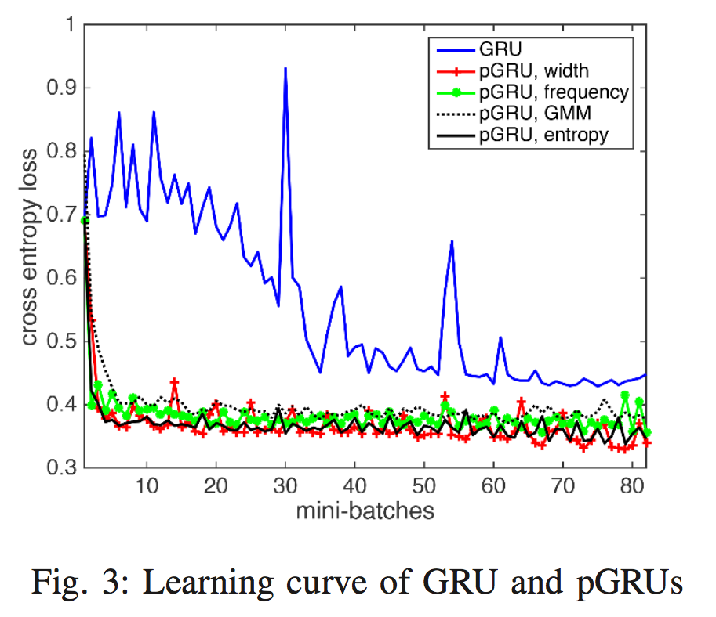
Results: learning curve

Slide 46
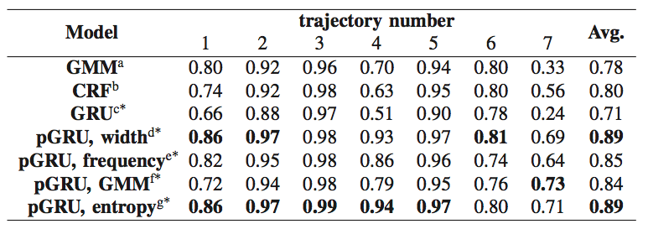
Results: F1 score
pGRUs perform better than GMM, CRF, GRU
equal-width and entropy-based method: better than other partition methods
equal-frequency binning: sensitive to high density regions
GMM: sensitive to noise when variance is small

Slide 47
Discussion
batch 7 performs worst among all methods
out-of-distribution data
pGRU still performs better than others

Slide 48
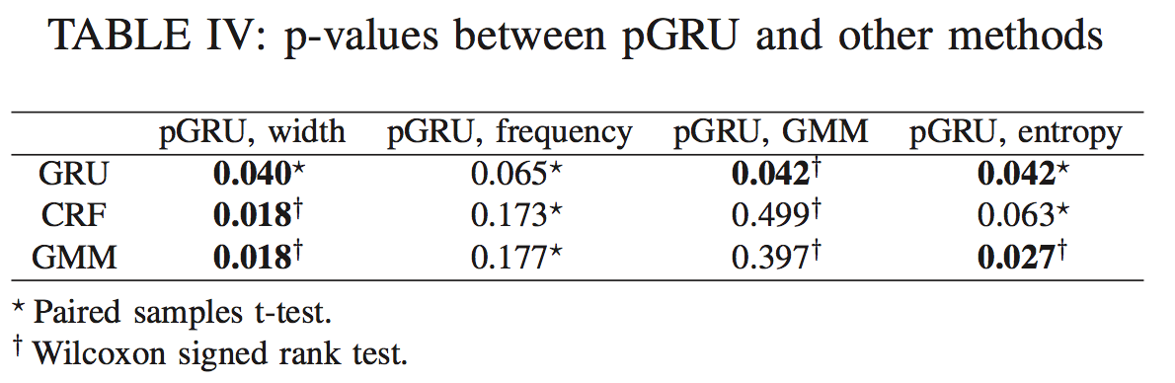
Significance Test

Slide 49
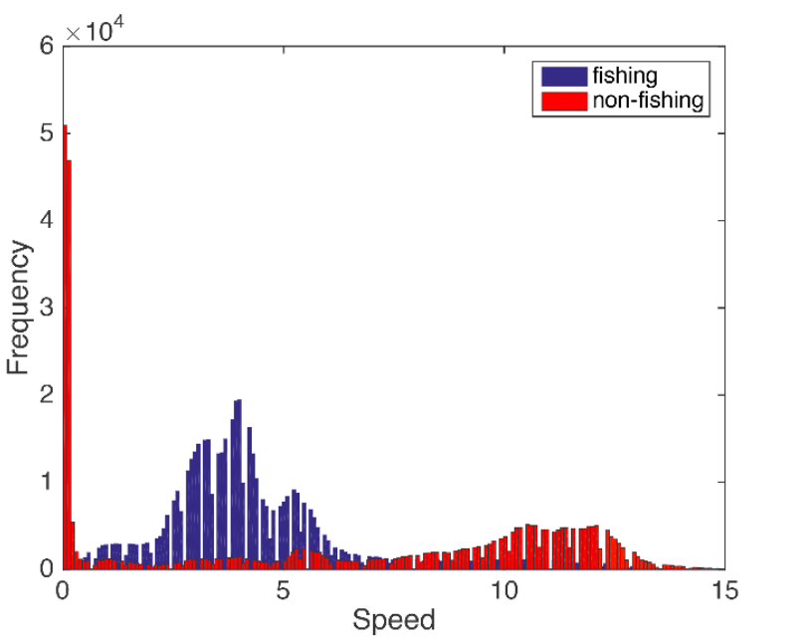
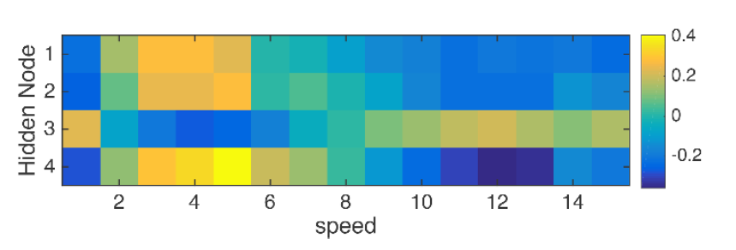
Visualizing learned activation function
learns conditional probability
better separability
learns embedding (basis expansion)
compositions in higher layers

Slide 50
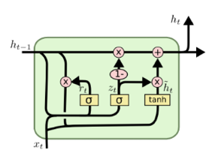
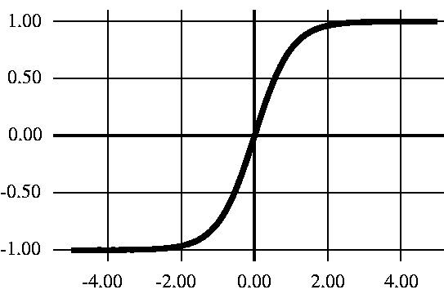
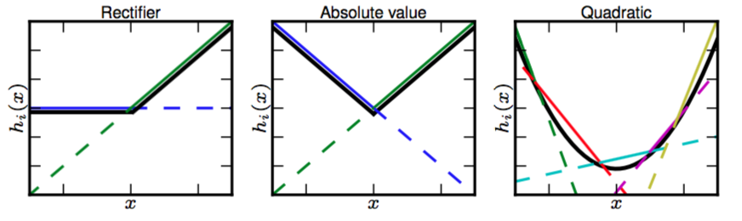
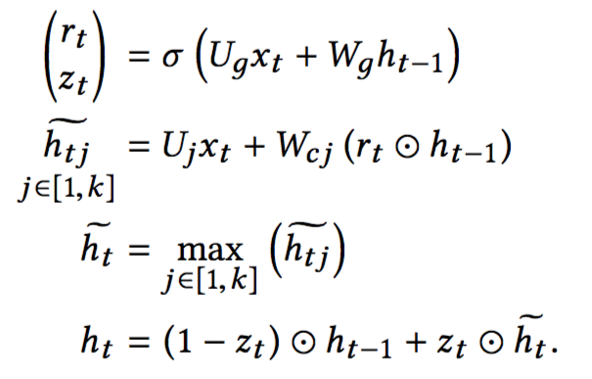
Maxout Gated Recurrent Units
Gated Recurrent Unit
tanh
(Cho et al., 2014)
(Goodfellow et al., 2013)

